Slide 1
MySQL Enterprise Edition Essential for Oracle DBA
Hananto Wicaksono
MySQL Principal Solution Engineer
Oracle MySQL, JAPAC
Oracle Database Certified Professional (OCP)
February, 2021

Slide 2
Agenda
History of MySQL
Introduction to Storage Engine
Oracle Instances vs MySQL Memory Structure and Threads
Database Files
Database Schemas
Monitoring and Tuning
Backup, Recovery, and Cloning
MySQL Database Security
MySQL Replication and InnoDB Cluster
Notes:
mysql> show engine innodb status\G;
MyISAM: Indexed Sequential Access Method
Compressed tables read-only (via myisampack)
Compression is reversible (myisamchk –unpack).
Locking is at Table level
holes / fragmented tables reduce insert contention -> set concurrent-insert = 2.
Blocking online backups
no crash recovery.
No FK.
Write requests before Read requests.
InnoDB Innobase Oy (www.innodb.com)
MEMORY Limited by max_heap_table_size.
Old “HEAP” SE.
Hash idx for = or <=> operands.
create table … engine MEMORY max_rows
--init-file to automatically load data on startup.
CSV .CSV at os level.
no indexing nor partitioning.
repairing corrupt might loose data.
ARCHIVE .ARZ & then .ARN files.
No indexes allowed, other than auto_increment.
Select & insert ops. No update, replace or delete.
Compression buffer.
BLACKHOLE replicate-do-* / replicate-ignore-* dummy master
measure overhead of binlog
MRG_MYISAM exact same MyISAM tables
Partitioning is another solution, not limited to MyISAM.
INSERT_METHOD means none,

Slide 3


Slide 4
The Latest Release ： MySQL 8.0.23
1995
2000
2005
2008
2010
2015
2018
2020
MySQL
Sun
Oracle
MySQL 5.1
MySQL 5.6
MySQL 8.0
2020-10-10 : 8.0.22
2020-07-13 : 8.0.21
2020-04-27 : 8.0.20
2020-01-13 : 8.0.19
2019-10-14 : 8.0.18
2019-07-22 : 8.0.17
2019-04-25 : 8.0.16
2019-02-01 : 8.0.15 / 2019-01-21 : 8.0.14
2018-10-22 : 8.0.13
2018-07-27 : 8.0.12
2018-04-19 : 8.0.11 General Availability
MySQL 5.5
MySQL 5.7
25 Years
10 years in Oracle since 2010

Slide 5
Introduction to Storage Engines

Slide 6
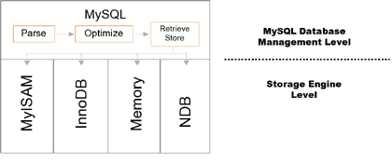
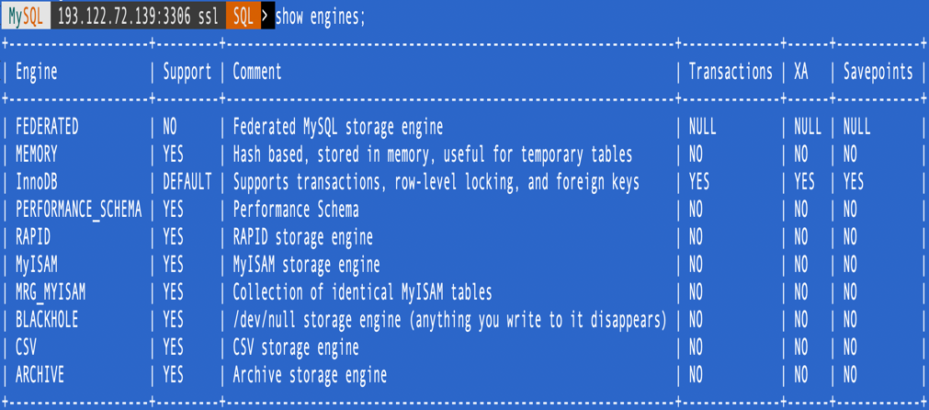
What is a Storage Engine …. and why should I care?
Performance, Concurrency, & Locking (careful……).
Processing model.
Upper tier, mysqld parses & optimizes SQL in order to retrieve / store.
Lower tier: Storage Engine dependant.
Transparent to the end user.
What IS storage engine dependent:
Storage, transactional, locking, BnR, optimization (data retrieval/storing), special features.
Notes:
mysql> select table_schema, engine, count(*) from tables group by table_schema, engine;
+--------------------+--------------------+----------+
| table_schema | engine | count(*) |
+--------------------+--------------------+----------+
| char_temp | InnoDB | 2 |
| information_schema | MEMORY | 48 |
| information_schema | MyISAM | 10 |
| mysql | CSV | 2 |
| mysql | InnoDB | 5 |
| mysql | MyISAM | 23 |
| performance_schema | PERFORMANCE_SCHEMA | 52 |
| sakila | NULL | 7 |
| sakila | InnoDB | 15 |
| sakila | MyISAM | 1 |
| test | InnoDB | 1 |
| world_innodb | InnoDB | 4 |
+--------------------+--------------------+----------+

Slide 7
What is a Storage Engine …. and why should I care? Types.
InnoDB (default >=5.5.5)
OLTP, Referential Integrity, Row Locking, FullText, GIS, JSON, NoSQL, InnoDB Cluster, crash recoverable, Multiple Buffers & Caches.
MyISAM (default <5.5.5)
.MYD/.MYI portable files, high compression, FullText & GIS search, Fixed row format for speed, concurrent inserts, writes precede over selects.
MEMORY
fast performance, .frm files on disk, fixed length rows, hash & btree indexes, table contents temporary*, --init-file.
NDB (Cluster)
Specific to Cluster: HA, OLTP, replicas, partitions & fragments, server aware, etc.
CSV, BLACKHOLE, EXAMPLE, ARCHIVE, MERGE/MRG_MYISAM...
Notes:
mysql> show engine innodb status\G;
MyISAM: Indexed Sequential Access Method
Compressed tables read-only (via myisampack)
Compression is reversible (myisamchk –unpack).
Locking is at Table level
holes / fragmented tables reduce insert contention -> set concurrent-insert = 2.
Blocking online backups
no crash recovery.
No FK.
Write requests before Read requests.
InnoDB Innobase Oy (www.innodb.com)
MEMORY Limited by max_heap_table_size.
Old “HEAP” SE.
Hash idx for = or <=> operands.
create table … engine MEMORY max_rows
--init-file to automatically load data on startup.
CSV .CSV at os level.
no indexing nor partitioning.
repairing corrupt might loose data.
ARCHIVE .ARZ & then .ARN files.
No indexes allowed, other than auto_increment.
Select & insert ops. No update, replace or delete.
Compression buffer.
BLACKHOLE replicate-do-* / replicate-ignore-* dummy master
measure overhead of binlog
MRG_MYISAM exact same MyISAM tables
Partitioning is another solution, not limited to MyISAM.
INSERT_METHOD means none,

Slide 8


What is a Storage Engine …. and why should I care? Types.
Let’s Start first with
InnoDB Storage Engine and MySQL 8.0
Notes:
mysql> show engine innodb status\G;
MyISAM: Indexed Sequential Access Method
Compressed tables read-only (via myisampack)
Compression is reversible (myisamchk –unpack).
Locking is at Table level
holes / fragmented tables reduce insert contention -> set concurrent-insert = 2.
Blocking online backups
no crash recovery.
No FK.
Write requests before Read requests.
InnoDB Innobase Oy (www.innodb.com)
MEMORY Limited by max_heap_table_size.
Old “HEAP” SE.
Hash idx for = or <=> operands.
create table … engine MEMORY max_rows
--init-file to automatically load data on startup.
CSV .CSV at os level.
no indexing nor partitioning.
repairing corrupt might loose data.
ARCHIVE .ARZ & then .ARN files.
No indexes allowed, other than auto_increment.
Select & insert ops. No update, replace or delete.
Compression buffer.
BLACKHOLE replicate-do-* / replicate-ignore-* dummy master
measure overhead of binlog
MRG_MYISAM exact same MyISAM tables
Partitioning is another solution, not limited to MyISAM.
INSERT_METHOD means none,

Slide 9
Oracle Instances vs MySQL Memory Structure and Threads

Slide 10
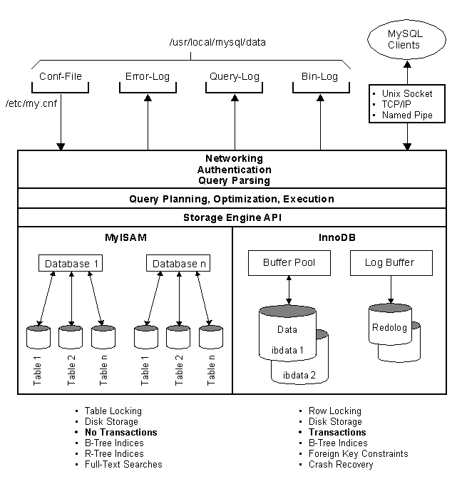
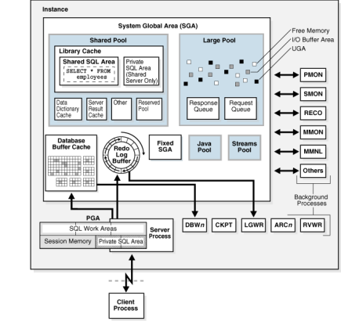
Architecture Overview
Oracle Instance: Memory + Multiple Processes
< 12c : always multi-processes (except on Windows)
version 12c => :
THREADED_EXECUTION=FALSE (multi-processes)
THREADED_EXECUTION=TRUE (multi-treaded mode)
MySQL Server: Memory + Single Process multi threads

Slide 11
SGA Memory Structure vs MySQL Memory Structure
Oracle Database | MySQL Database
Buffer Cache Function: Main memory to cache index and data | InnoDB Buffer Pool Function: Main memory to cache index and data
Redo Log Buffer Function: Cache data before being written to redo log file | InnoDB Redo Log Buffer Function: Cache data before being written to redo log file
Shared Pool: Library Cache Function: Cache SQLs Cache Exec. plan for soft parse | Query Cache Function: Cache SELECT statement Cache result from the SELECT statement
Shared Pool: Data Dictionary Cache Function: Hold dictionary data that stores information about database objects | Dictionary Object Cache Function: Hold dictionary data that stores information about database objects
Consider to increase innodb_log_buffer_size to enable large transaction to run without write to the disk before commit

Slide 12
PGA Memory Structure vs MySQL Memory Structure
Oracle Database | MySQL Database
Sort Area Function: Sort Operation | Sort Buffer Function: Sort Operation
Hash Area Function: Hash join | Join Buffer Function: Hash join, index and ALL join
Stack Area Function: Hold system parameters, arrays and other info | Thread Stack Function: Hold system variables, arrays and other info
MySQL does not support automatic memory management
Each memory has to be specified individually and manually
Allocate memory area for each thread as needed
Set innodb_dedicated_server=ON for auto tuning setting / configuration for dedicated instance on a server

Slide 13
When INNODB_DEDICATED_SERVER=ON ...
Auto-tuned system variables | Description
INNODB_BUFFER_POOL_SIZE | Set buffer pool size based on RAM size (< 1 GB: 128 MiB; 1 GB - 4 GB: RAM * 0.5; 4 GB < : RAM * 0.75)
INNODB_LOG_FILE_SIZE | Set log buffer size based on buffer pool size (< 8 GB: 512 MiB; 8 GB - 128 GB: 1024 MiB; 128 GB < : 2048 MiB)
INNODB_LOG_FILES_IN_GROUP | Number of Redo Logs based on buffer pool size (< 8GB: round(buffer pool size), 8 GB -128 GB: round(buffer pool size * 0.75), 128 GB < : 64)
INNODB_FLUSH_METHOD | Set Flush Method to O_DIRECT_NO_FSYNC
Enabling innodb_dedicated_server is not recommended if the MySQL instance shares system resources with other applications.

Slide 14
Oracle Processes vs MySQL Threads
Function | Oracle Database | MySQL Database
Represent client operation on a server | Server Process | Connection Thread
I/O Read from data files to memory buffer | Server Process * Cache data on SGA (Buffer cache) | innodb_read_io_threads * Cache data on InnoDB buffer pool
I/O write from memory to data files | DB Writer processes (DBWR) | Innodb_write_io_threads
I/O write from redo log buffer to redo log file | Log Writer (LGWR) | Log Writer
To perform database checkpoint | Checkpoint (CKPT) | Log Checkpointer
Receive trans. log from PRIMARY | Remote File Server (RFS) * Write to standby archive log | Slave I/O Thread * Write to relay log
Commit trans. log on STANDBY / Replica | Managed Recovery Process (MRP) * Read from standby archive log | Slave SQL Thread * Read from relay log

Slide 15
Oracle Processes vs MySQL Threads
Function | Oracle Database | MySQL Database
Write to Archive log or Binlog | Archiver (ARCH) Active when instance is running on Archive Mode Format: binary row Write from redo log file during log switch ALTER DATABASE ARCHIVE LOG CURRENT or ALTER DATABASE SWITCH LOGFILE to generate new archive log Used for PITR Used for standby database | Connection Thread Active when database is running with log_bin=ON Format: binary row, statement, or mixed Write during statement commit, just before table locks are released FLUSH BINARY LOGS to start writing Binlog event to a new file Used for PITR Used for replication

Slide 16
Transaction Locks and Concurrency
Isolation Level | Description | Oracle | MySQL
READ-UNCOMMITTED | Transactions can view uncommitted transactions |  | ✓
REPEATABLE-READ | Any rows transaction reads will look the same in subsequent read within the same transaction |  | ✓ (default)
READ-COMMITTED | See only those transactions that are committed | ✓ (default) | ✓
SERIALIZE | Forcing transactions to be ordered | ✓ | ✓
set transaction_isolation = ‘READ-COMMITTED’ on MySQL

Slide 17
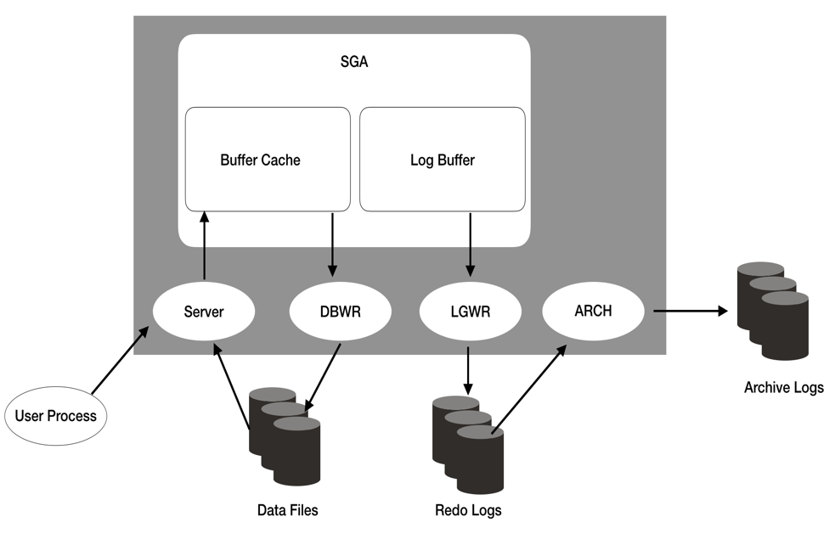
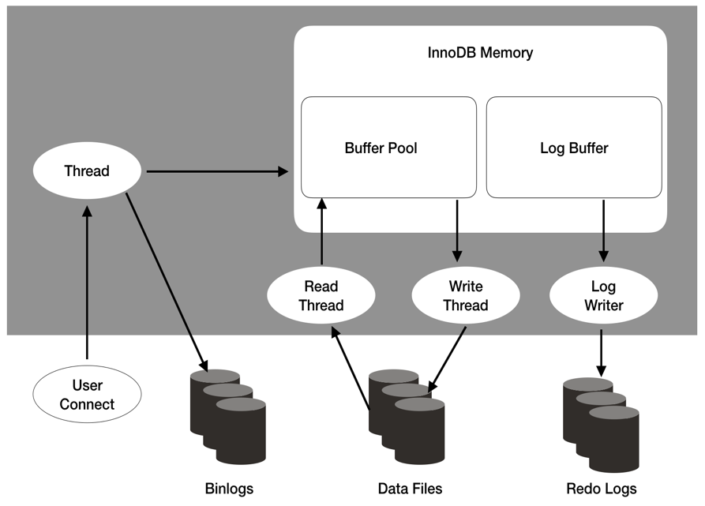
Transaction Committing and Archiving Process
Oracle Database
MySQL Database

Slide 18
Optional Configuration on MySQL for Transaction Committing and Archiving
system variables | Description
INNODB_ADAPTIVE_FLUSHING | Set ON to dynamically adjust the rate of flushing dirty pages in the InnoDB buffer pool based on the workload.
INNODB_FLUSH_LOG_AT_TRX_COMMIT | Timing to flush redo log into redo log files 1: immediate on every commit 2: periodic every 1 sec for committed transaction logs 0: periodic every 1 sec for logs If innodb_flush_log_at_trx_commit <> 1, set innodb_flush_log_at_timeout to guarantee flushing every N secs.
SYNC_BINLOG | Timing to flush Binlog event to Binary logs 1: immediate right before transaction is committed 0: relies on OS to flush binary logs <1: collect N binary logs commit group before flushing

Slide 19
Database Files

Slide 20
Physical Database Structure
Oracle Database
MySQL Database
Control Files
Data Files
Redo Logs
Data Files
Redo Logs
PFILE
SPFILE
Password File
Option File
mysqld-auto.cnf
Archive logs
Alert/Trace
RMAN
Backup Files
Binary logs
error-log/
general-log
MEB
Backup Files

Slide 21
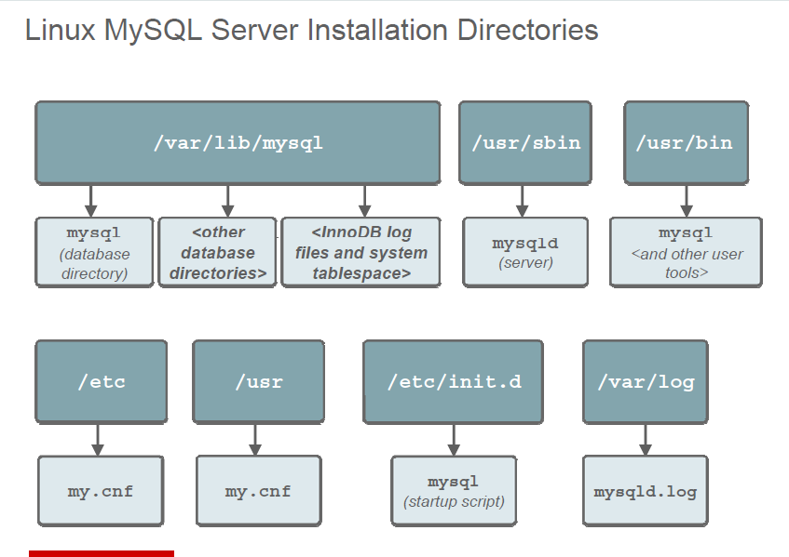
MySQL Database File Location

Slide 22
Setting Database Files Location
Function | Oracle | MySQL
Define location of default file system directory for data files | DB_CREATE_FILE_DEST | INNODB_DATA_HOME_DIR * SYSTEM tablespace only INNODB_UNDO_DIRECTORY * UNDO tablespace only All other tablespaces are not affected
Define location of default file system directory for temporary files | DB_CREATE_FILE_DEST | INNODB_TEMP_TABLESPACES_DIR for ibtmp1 INNODB_TEMP_DATA_FILE_PATH for Global Temporary table (default: ibtmp1)
Define location for redo log files | DB_CREATE_ONLINE_LOG_DEST_n | INNODB_LOG_GROUP_HOME_DIR

Slide 23
Setting Database Files Location
Function | Oracle | MySQL
Define location of Archive logs or Binary Logs | LOG_ARCHIVE_DEST | LOG_BIN
Location of database server log | DIAGNOSTIC_DEST BACKGROUND_DUMP_DEST (deprecated) | LOG_ERROR
Define trace logs | $ADR_HOME USER_DUMP_DEST (deprecated) | GENERAL_LOG_FILE (Set GENERAL_LOG = 1 | ON to activate query logging)

Slide 24
Database Configuration Files
Function | Oracle | MySQL
Initialization variables: Store instance parameters setting to flat file. Require for starting an instance Not dynamic and require instance restart to take effect | Parameter File (PFILE) Default file name : Init<INSTANCE_NAME>.ora | Option File Default file name: my.cnf or my.ini
Initialization variables: Store instance parameters setting to a special file format Optionally require for starting an instance Dynamic and does not require instance restart for new setting to take effect | SPFILE Format: binary Default file name: spfile<INSTANCE_NAME>.ora | mysqld-auto.cnf Format: JSON

Slide 25
MySQL Option Files (SAMPLE)
[mysqld]
innodb_buffer_pool_size = 1024M
datadir = /u01/data
port = 3306
max_connections = 4096
sql_mode = ORACLE
sort_buffer_size = 10M
character_set_server = utf8mb4
[client]
default_character_set = utf8mb4
MySQL System Variables | Function | Related Parameter in Oracle
Datadir | Default location of database file directory | DB_CREATE_FILE_DEST
port | Default database listening port (default: 3306) | LISTENER PORT (default: 1521)
max_connections | Maximum user connection threads (default: 151) | SESSIONS
sort_buffer_size | Setting sort buffer for ORDER BY or GROUP BY | SORT_AREA_SIZE
mysqld-auto.cnf (SAMPLE)
{ "Version" : 1 , "mysql_server" : { "gtid_executed_compression_period" : { "Value" : "500" , "Metadata" : { "Timestamp" : 1612726568746164 , "User" : "root" , "Host" : "localhost" } } } }

Slide 26
Check database parameter setting
Oracle | MySQL
show parameter; show parameter parameter_name; show parameter <string>; select * from v$parameter; select * from v$system_parameter; | show variables; show variables like ‘<variable_name>’; show variables like ‘%<string>%’; select * from performance_schema.session_variables; select * from performance_schema.global_variables;

Slide 27
Changing Database Parameters on-the-fly
Function | Oracle | MySQL
Set on Memory and persist in database configuration file | Target File: SPFILE Syntax: alter system set <parameter>=<value> scope=BOTH; | Target File: mysqld-auto.cnf Syntax: set PERSIST <variables>=<values>;
Set on Memory only or for current session | Syntax: alter system set <parameter>=<value> scope=MEMORY; alter session set <parameter>=<value>; | Syntax: set global <variables>=<values>; set session <variables>=<values>;
Set on database configuration only | Target File: SPFILE Syntax: alter system set <parameter>=<value> scope=SPFILE; | Target File: mysqld-auto.cnf Syntax: set PERSIST_ONLY <variables>=<values>;

Slide 28
Special Schemas and Tablespaces
Schemas and Tablespaces | Oracle | MySQL
Stores Database Data Dictionary and System related information | SYS and SYSTEM Schema | SYS, MYSQL, and INFORMATION_SCHEMA
Store Performance Statistics data | SYSAUX tablespace to store AWR related table on disk | PERFORMANCE_SCHEMA to store in MEMORY
Rollback segments for rolling back uncommitted transaction and store before image for MVCC (read consistency) | UNDO Tablespace | UNDO Tablespace
Temporary segments for sorting operation and temporary tables | TEMP Tablespace | TEMP Tablespace

Slide 29
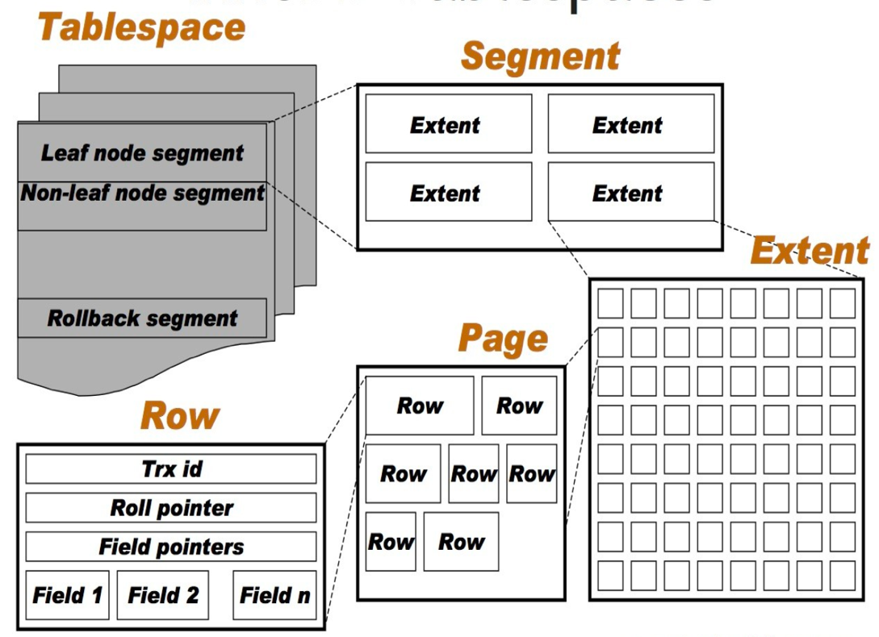
Tablespaces Architecture
DB_BLOCK_SIZE (ORACLE) = 8192 (8 KB - default), extent size is varying; but uniform extent size can be defined on a Locally Managed Tablespace
INNODB_PAGE_SIZE (MySQL) = 16384 (16 KB - default) with uniform extent size = 1 MB (64 pages)
Once data is growing, extensions occur in increment of 4 MB (4 extents)

Slide 30

Tablespaces Architecture
Oracle Tablespace
(General Tablespace)
InnoDB Tablespace
(File Per Table)
Data File(s)
Data File
Segment (table)
Segment (table)
Segment (table)
Segment (table)
Segment (table)
Segment (table)
Extents
Extents
Extents
Extents
Extents
Extents
Extents
Extents
Extents
Extents

Slide 31
Data file - General Tablespace Support(From MySQL 5.7)
[USER01]> CREATE TABLESPACE U_TABLESPACE01 ADD DATAFILE '/home/mysql/user_tablespace01.ibd' Engine=InnoDB;
Query OK, 0 rows affected (0.01 sec)
[USER01]> CREATE TABLESPACE U_TABLESPACE02_8K ADD DATAFILE '/home/mysql/user_tablespace02_8k.ibd' FILE_BLOCK_SIZE=8192 Engine=InnoDB;
Query OK, 0 rows affected (0.01 sec)
[USER01]> CREATE TABLE `T_USER01` (
> `id` int(11) NOT NULL AUTO_INCREMENT, `text` varchar(100) DEFAULT NULL, PRIMARY KEY (`id`)
> ) TABLESPACE=U_TABLESPACE01 ENGINE=InnoDB AUTO_INCREMENT=1 DEFAULT CHARSET=utf8mb4;
Query OK, 0 rows affected (0.01 sec)
[USER01]> CREATE TABLE `T_USER02_8K` (
> `id` int(11) NOT NULL AUTO_INCREMENT, `text` varchar(100) DEFAULT NULL, PRIMARY KEY (`id`)
>) TABLESPACE=U_TABLESPACE02_8K ENGINE=InnoDB AUTO_INCREMENT=1 DEFAULT CHARSET=utf8mb4
> ROW_FORMAT=COMPRESSED KEY_BLOCK_SIZE =8;
Query OK, 0 rows affected (0.00 sec)
[USER01]> SELECT * FROM information_schema.INNODB_SYS_TABLESPACES where NAME like 'U_%';
+-------+-------------------+------+-------------+------------+-----------+---------------+------
| SPACE | NAME | FLAG | FILE_FORMAT | ROW_FORMAT | PAGE_SIZE | ZIP_PAGE_SIZE | SPACE
+-------+-------------------+------+-------------+------------+-----------+---------------+------
| 27 | U_TABLESPACE01 | 2048 | Any | Any | 16384 | 0 | Gener
| 28 | U_TABLESPACE02_8K | 2089 | Barracuda | Compressed | 16384 | 8192 | Gener
+-------+-------------------+------+-------------+------------+-----------+---------------+------
InnoDB supports multiple tables on single datafile per general tablespace

Slide 32
Automatic truncation of rollback segment (From MySQL 5.7)
[root@misc02 admin]# mysql -u root -p -e "show variables like '%undo%'"
Enter password:
+--------------------------+----------+
| Variable_name | Value |
+--------------------------+----------+
| innodb_max_undo_log_size | 33554432 |
| innodb_undo_directory | ./ |
| innodb_undo_log_truncate | ON |
| innodb_undo_logs | 128 |
| innodb_undo_tablespaces | 3 |
+--------------------------+----------+
[root@misc02 admin]# ls -l /usr/local/mysql/data/undo00*
-rw-r-----. 1 mysql mysql 10485760 11月 20 08:24 /usr/local/mysql/data/undo001
-rw-r-----. 1 mysql mysql 10485760 11月 20 08:24 /usr/local/mysql/data/undo002
-rw-r-----. 1 mysql mysql 10485760 11月 20 08:24 /usr/local/mysql/data/undo003
[root@misc02 admin]#
Undo segments are divided into insert undo buffer for insert and update undo buffer for update
Turn on automatic truncation, need to set two or more undo datafiles
From MySQL 5.7, automatic truncation of rollback segments was implemented
Related parameters ：innodb_undo_log_truncate, innodb_purge_rseg_truncate_frequency, innodb_purge_threads

Slide 33
Optimize table (Oracle Term: Table Re-Org)
Reorganizes the physical storage of table data and associated index data after massive DML or housekeeping:
to reduce storage space on INNODB_FILE_PER_TABLE
to improve I/O efficiency when accessing the table
Optimize table uses online DDL for InnoDB to shorten downtime on concurrent DML (after version 5.6.17)
Brief XLOCK during prepare phase to lock over metadata during a intermediate table creation
Brief XLOCK during commit phase during committing table metadata changes.
Cannot be done using INPLACE algorithm when FULLTEXT indexes are present which cause a longer downtime for DML

Slide 34
Database Schemas

Slide 35
Databases and Schemas Diagram
Oracle Database MySQL Server
In MySQL Server, DATABASE and SHCEMA have the same meaning
In the database, objects such as tables, Indexes, stored programs, etc. are stored
There is no concept of "schema owner"
Even if you delete a user, an object such as a table created by that user is not deleted
PMON
CKPT
SMON
ARCx
INIT.ORA
MY.CNF
MYSQLD
DBWx
RECO
DATA DICTIONARY
INFORMATION SCHEMA
LGWR
RMAN
database
schemas
databases =schema
…
…
tables indexes
tables indexes
…
…

Slide 36
Schema Objects
ORACLE
MySQL
CLUSTER
CONTEXT
CONTROL FILE
DATABASE
DATABASE LINK
DIMENSION
DIRECTORY
EVENT
FUNCTION
INDEX
INDEX TYPE
JAVA
LIBRARY
MATERIALIZED VIEW
MATERIALIZED VIEW LOG
OPERATOR
OUTLINE
PACKAGE,PACKAGE BODY
PROCEDURE
PFILE
PROFILE
ROLE
ROLLBACK SEGMENT
SCHEMA
SEQUENCE
SNAPSHOT
SNAPSHOT KEY
SYNONYM
TABLE
TABLESPACE
TEMP TABLESPACE
TRIGGER
TYPE
TYPE BODY
USER
VIEW
DATABASE
FUNCTION
INDEX
PROCEDURE
TABLE
TRIGGER
VIEW
EVENT
USER

Slide 37
Oracle Schema Objects that do not exist in MySQL
TYPE
Synonyms
Materialized Views
Dimensions
Sequences (MySQL uses AUTOINCREMENT columns)
Bitmap Indexes
Global Partitioned Indexes
Packages (although MySQL does have stored procedures)
Java Stored Procedures
DDL Triggers

Slide 38
Data Types
Note the difference in numerical type
Oracle Database | MySQL Server
CHAR, VARCHAR2, NCHAR, NVARCHAR | CHAR, VARCHAR, TEXT
CLOB, LONG | LONGTEXT
RAW | MEDIUMBLOB
LONG RAW, BLOB | BLOB
BFILE | None
NUMBER, DECIMAL | INT, BIGINT, DECIMAL
NUMBER (P,S), DECIMAL (P,S) | DECIMAL (P,S)
REAL, DOUBLE | DECIMAL
FLOAT | DOUBLE
DATE, TIMESTAMP | DATETIME,TIMESTAMP
※JSON data type (Binary) was added from MySQL 5.7

Slide 39
Data Types
Character related
Character set
Since they are not completely identical, they need to be mapped to a similar one (4 bytes UTF8 is supported as utf8mb4 since MySQL 5.5)
Normally you can use cp932, eucjpms, utf8, utf8mb4 OK
Length designation
Oracle is the number of bytes, MySQL is the number of characters
Presence of half-width padding when the data is shorter than the definition in the CHAR type
MySQL does not pad by default
When padding, specify PAD_CHAR_TO_FULL_LENGTH for sql_mode

Slide 40
Data Types
Character related & date related
Character comparison
MySQL not case sensitive
Distinguish by specifying * _bin or * _ cs for Collation
Null and zero length character comparison
Oracle identifies NULL and VARCHAR2 of zero length, but distinguishes non-Oracle databases
No function corresponding to NLS_DATE_FORMAT
Use the DATE_FORMAT () function
There is datatime_format in the setting parameter but not available, deprecated

Slide 41
SQL Mode
Change behavior of MySQL server against SQL statement
Options to "make" MySQL server behavior "close" to other databases
Prohibition of automatic type conversion
SQL syntax and table definition compatibility
Security related
Combination mode ：ORACLE
SQL syntax compatibility related PIPES_AS_CONCAT, ANSI_QUOTES, IGNORE_SPACE
Remove MySQL dependent option from SHOW CREATE TABLE statement NO_KEY_OPTIONS, NO_TABLE_OPTIONS, NO_FIELD_OPTIONS
Prohibition of automatic creation of users by GRANT statement NO_AUTO_CREATE_USER

Slide 42
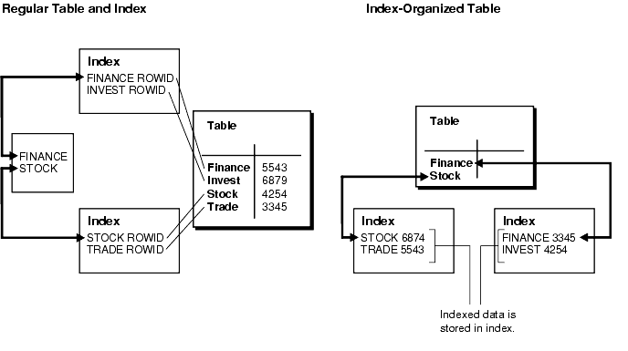
Clustered Index vs Secondary Index (Oracle term: Heap-organized table vs Index-organized Table)
Clustered index or Index Organized Table (IOT):
Store data and its index on the same place, whereby record is stored in leaf node of an index for very fast access
PRIMARY KEY is clustered index (IOT) on InnoDB
Secondary index is regular index on a heap table

Slide 43
Optimization
Oracle Database | MySQL Server
Cost based Optimizer (CBO) | Cost Based Optimizer (CBO)
Update table / index statistics in DBMS_STATS package | Update table / index statistics with ANALYZE TABLE command
Store execution plan in PLAN_TABLE table using EXPLAIN PLAN | Display execution plan with EXPLAIN
Check SQL execution status and execution plan with Diagnostics Pack (optional function) of Enterprise Manager | The execution status of SQL can be confirmed with Query Analyzer of Enterprise Monitor Execution plan can be confirmed in MySQL Workbench
Histogram | Histogram
Data compression possible | Data compressibility (InnoDB, Archive)

Slide 44
Analyze Table (Oracle Term: DBMS_STATS.GATHER_TABLE_STATS)
Works with InnoDB, NDB, and MyISAM
Generate table STATISTICS: performs a key distribution analysis and stores the distribution into Data Dictionary for CBO
UPDATE HISTOGRAM clause generates histogram statistics
DROP HISTOGRAM clause removes histogram statistics
SHOW INDEX to check the stored key distribution cardinality or Query from INFORMATION_SCHEMA.STATISTICS for table index statistics cached value
MYSQL.INNODB_TABLE_STATS stores persistent statistics for table
MYSQL.INNODB_INDEX_STATS stores persistent statistics for index
MySQL does not have DBMS_STATS.GATHER_SCHEMA_STATS

Slide 45
Note: Save statistics information
Innodb_stats_persistent specifies whether to keep InnoDB index statistics on disk. As the statistical information changes, the execution plan of the query may change.
Innodb_stats_auto_recalc determines whether statistics are calculated automatically whenever significant changes are made to the table (more than 10% of the row).
root@localhost [mysql]> show variables like '%STATS%';
+--------------------------------------+---------------+
| Variable_name | Value |
+--------------------------------------+---------------+
| innodb_stats_auto_recalc | ON |
| innodb_stats_method | nulls_equal |
| innodb_stats_on_metadata | OFF |
| innodb_stats_persistent | ON |
| innodb_stats_persistent_sample_pages | 20 |
| innodb_stats_sample_pages | 8 |
| innodb_stats_transient_sample_pages | 8 |
| myisam_stats_method | nulls_unequal |
+--------------------------------------+---------------+

Slide 46
Note: Manual update of statistical information by analyze table command
[sakila]> select * from mysql.innodb_table_stats where database_name = 'sakila' and table_name = 'city';
+---------------+------------+---------------------+--------+----------------------+--------------------------+
| database_name | table_name | last_update | n_rows | clustered_index_size | sum_of_other_index_sizes |
+---------------+------------+---------------------+--------+----------------------+--------------------------+
| sakila | city | 2015-10-02 20:57:09 | 600 | 3 | 1 |
+---------------+------------+---------------------+--------+----------------------+--------------------------+
1 row in set (0.00 sec)
[sakila]> analyze table city;
+-------------+---------+----------+----------+
| Table | Op | Msg_type | Msg_text |
+-------------+---------+----------+----------+
| sakila.city | analyze | status | OK |
+-------------+---------+----------+----------+
1 row in set (0.00 sec)
[sakila]> select * from mysql.innodb_table_stats where database_name = 'sakila' and table_name = 'city';
+---------------+------------+---------------------+--------+----------------------+--------------------------+
| database_name | table_name | last_update | n_rows | clustered_index_size | sum_of_other_index_sizes |
+---------------+------------+---------------------+--------+----------------------+--------------------------+
| sakila | city | 2015-11-23 07:55:22 | 600 | 3 | 1 |
+---------------+------------+---------------------+--------+----------------------+--------------------------+

Slide 47
Monitoring and Tuning

Slide 48
Terminology
Wait Time: the amount of time during which a requested task is inactive or waiting to be processed
Service Time: Actual time taken to process the query
Response Time = Service Time + Wait Time

Slide 49
Tips
• Be wary about “best practices”
– No two systems are the same
– What was true earlier may no longer hold
– Think – consider what you are doing!
– Monitor your system
• Ensure you test your changes before deploying to production
– The testing must reflect your production usage
• Make incremental changes
– One change at a time
– Relatively small changes
• Be mindful of your requirements
– Some options give the choice between performance or data safety
– what do you need?
• Often the default value is the best value
• Ensure all tables have a PRIMARY KEY
• InnoDB organizes the data according to the PRIMARY KEY:
– The PRIMARY KEY is included in all secondary indexes in order to be able to locate the actual row => smaller PRIMARY KEY gives smaller secondary indexes.
– A mostly sequential PRIMARY KEY is in general recommended to avoid inserting rows between existing rows.

Slide 50
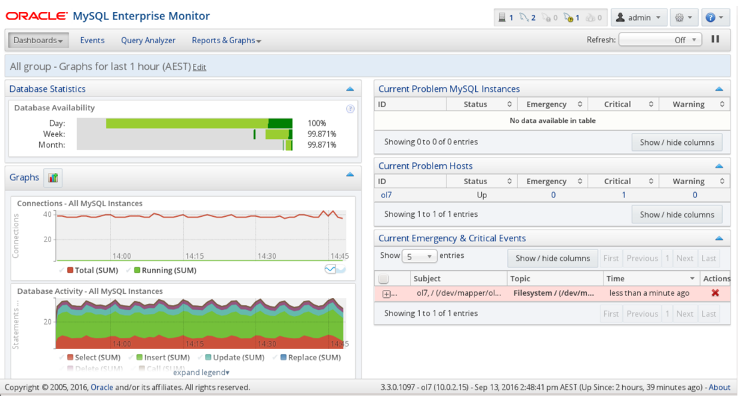
Monitoring
• Gives you a base line
• Tells you what has happened
– useful to investigate performance issues
• Allows you to proactively handle potential issues
Many options available:
– MySQL Enterprise Monitor
– MySQL Plugin for Oracle Enterprise Monitor
– Cacti
– Zabbix
– Nagios
– And many more
• Make sure you configure alerts so you react appropriately to all events based on the severity level!

Slide 51
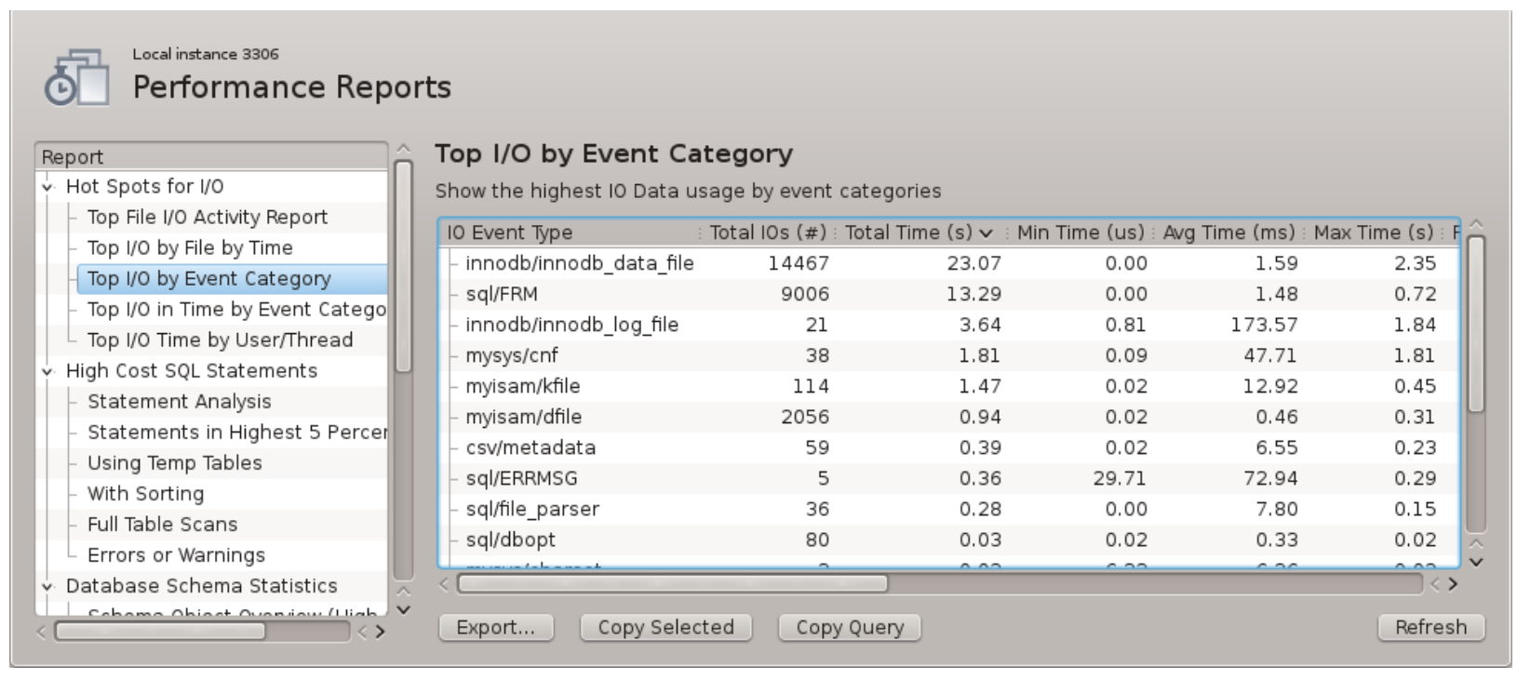
Workbench Performance Report

Slide 52
Monitoring has Overhead too
While monitoring is good, there is such as thing as too much monitoring
All monitoring has overhead (some more than others)
Particularly be careful with queries like:
SHOW PROCESSLIST
SHOW ENGINE INNODB STATUS
If performed too often they can cause an outage on their own
In 5.6+: Use PERFORMANCE_SCHEMA.THREADS instead of SHOW PROCESSLIST
SIMILAR to v$session and v$process in Oracle
MySQL also has x$session and x$processlist on SYS schema

Slide 53

SYS Schema
Simple view of Performance Schema and Information Schema
A view, procedure, and set of functions for convenient use
of the performance schema
Support database administrator task
Monitor key statistics such as operating statistics and growth rates
Detection, diagnosis and improvement of performance problems
With sys schema, simply check the details of the situation
Files and processing with high IO, high-cost SQL statement, lock
Table, index, schema statistics, latency and latency analysis, etc.
Created by default from MySQL 5.7

Slide 54
Use SYS Schema
• Also available from https://github.com/mysql/mysql-sys for MySQL 5.6
• Formerly known as PS_HELPER by Mark Leight
• Report: sys.Diagnostics (similar to AWR Report or STATPACK in Oracle)
AWR Report and STATPACK are using snapshots to generate report for specified period within 1 hour.
SYS.Diagnostics requires to be executed at the timing you want to diagnose.
current: Use the current instrument and consumer settings.
medium: Enable some instruments and consumers.
full: Enable all instruments and consumers.

Slide 55
sys schema – sample view (1)
Object Overview
[sys]> select * fromschema_object_overview where db = 'sys';
+-----+---------------+-------+
| db | object_type | count |
+-----+---------------+-------+
| sys | BASE TABLE | 1 |
| sys | INDEX (BTREE) | 1 |
| sys | TRIGGER | 2 |
| sys | FUNCTION | 21 |
| sys | PROCEDURE | 26 |
| sys | VIEW | 100 |
+-----+---------------+-------+
InnoDB Buffer Memory Usage
[sys]> select object_schema,object_name,allocated,data,pages,rows_cached from sys.innodb_buffer_stats_by_table order by data limit 0,5;
+---------------+--------------------+------------+------------+-------+-------------+
| object_schema | object_name | allocated | data | pages | rows_cached |
+---------------+--------------------+------------+------------+-------+-------------+
| sakila | staff | 16.00 KiB | 980 bytes | 1 | 2 |
| sakila | address | 32.00 KiB | 9.11 KiB | 2 | 95 |
| mysql | gtid_executed | 16.00 KiB | 70 bytes | 1 | 1 |
| sakila | actor | 16.00 KiB | 7.33 KiB | 1 | 200 |
| mysql | innodb_table_stats | 1.23 MiB | 610.75 KiB | 79 | 8406 |
+---------------+--------------------+------------+------------+-------+-------------+

Slide 56
sys schema – sample view (2)
user_summary_by_file_io_type
select * from user_summary_by_file_io_type order by latency desc limit 5;
+------------+---------------------------------+-------+----------+-------------+
| user | event_name | total | latency | max_latency |
+------------+---------------------------------+-------+----------+-------------+
| root | wait/io/file/csv/metadata | 64 | 94.09 ms | 74.15 ms |
| background | wait/io/file/sql/binlog | 25 | 9.20 ms | 7.59 ms |
| repl_user | wait/io/file/sql/binlog | 12 | 70.73 us | 27.35 us |
| background | wait/io/file/sql/global_ddl_log | 2 | 7.92 us | 6.45 us |
| root | wait/io/file/myisam/dfile | 423 | 68.84 ms | 47.79 ms |
+------------+---------------------------------+-------+----------+-------------+
statement_analysis
※By default, the total execution time is long and sorted
select LEFT(query,20),db,exec_count,total_latency,max_latency,avg_latency from statement_analysis limit 5;
+----------------------+-------+------------+---------------+-------------+-------------+
| LEFT(query,20) | db | exec_count | total_latency | max_latency | avg_latency |
+----------------------+-------+------------+---------------+-------------+-------------+
| SELECT DISTINCTROW ` | NULL | 1 | 9.77 s | 9.77 s | 9.77 s |
| SELECT `information_ | sys | 3 | 6.18 s | 5.54 s | 2.06 s |
| SELECT ( `UNIX_TIMES | mysql | 4461 | 5.13 s | 15.60 ms | 1.15 ms |
| SELECT DISTINCTROW ` | NULL | 1 | 3.70 s | 3.70 s | 3.70 s |
| SET SESSION `sql_mod | mysql | 4461 | 696.29 ms | 6.69 ms | 156.08 us |
+----------------------+-------+------------+---------------+-------------+-------------+

Slide 57
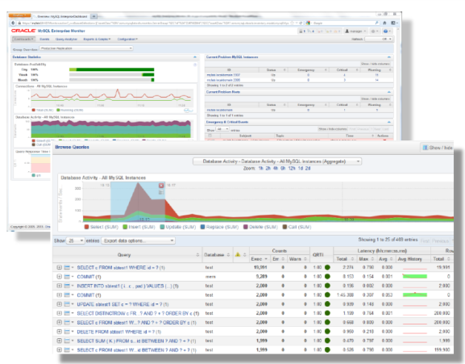
MySQL Enterprise Monitor
Detailed analysis of SQL performance with Query Analyzer (It is possible to hold data and analyze trends)
Monitoring MySQL environment
Resource usage status
Fault detection & notification
Performance monitoring
Replication monitoring
Trend analysis & precursor detection
Operation Advisor
Over 250 Advice
Best practices gained through
consulting and support

Slide 58
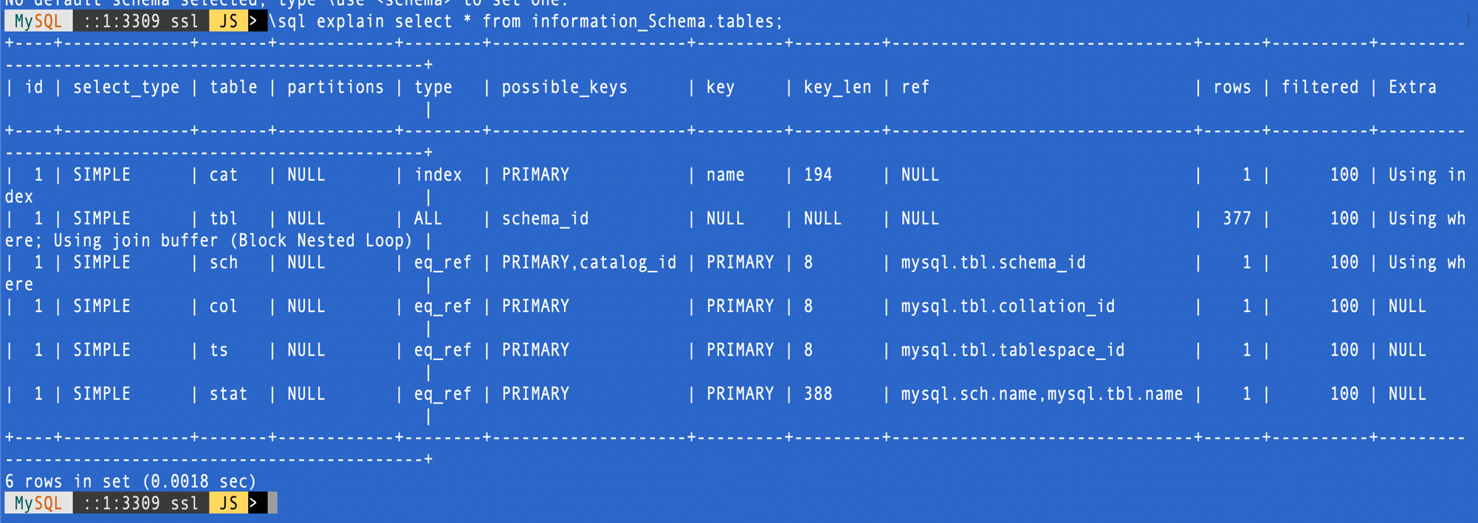
MySQL Explain Analyze + Explain Format
Classic – before MySQL 8.0

Slide 59
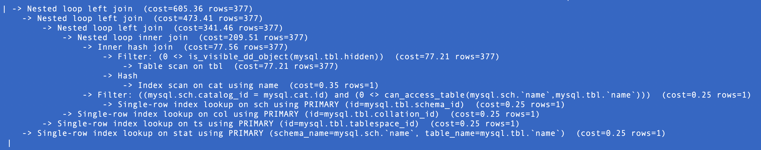
MySQL Explain Analyze + Explain Format
Explain Format=Tree
But it doesn’t tell us if those estimates are correct, or on which operations in the query plan the time is actually spent.

Slide 60
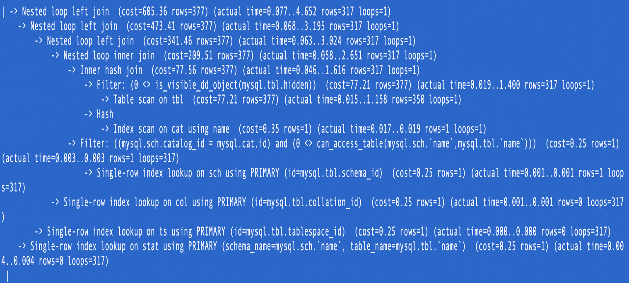
MySQL Explain Analyze + Explain Format
Explain Analyze
Actual time to get first row (in milliseconds)
Actual time to get all rows (in milliseconds)
Actual number of rows read
Actual number of loops

Slide 61
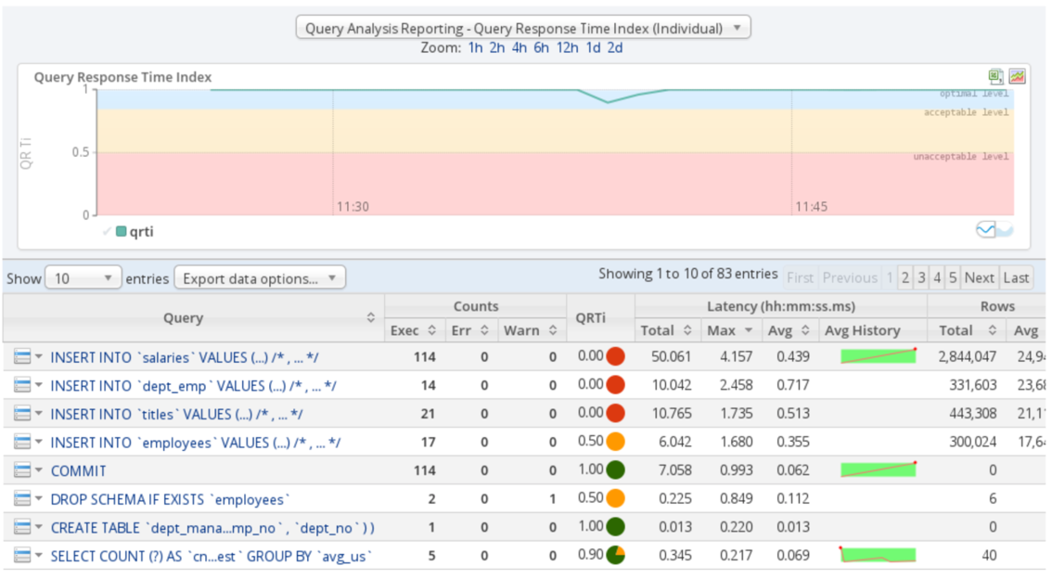
Query Tuning
Application metrics
Manually executing query and determining it is too slow or uses too many resources
Slow Query Log
MySQL Enterprise Monitor Query Analyzer
performance_schema.events_statements_summary_by_digest •
sys.statements_with_runtimes_in_95th_percentile

Slide 62
Query Response Time Index
Type | Default time values | Assigned value | Description | Color
Optimum | 100ms | 1.00 (100%) | The optimal time frame | Green
Acceptable | 4 * Optimum -- 100ms to 400ms | 0.50 (50%) | An acceptable time frame | Yellow
Unacceptable | Exceeds Acceptable -- greater than 400ms | 0.00 (0%) | An unacceptable time frame | Red
SAMPLE CALCULATION
( (60 + (30 / 2) + (10*0) ) / 100) = 0.75.

Slide 63
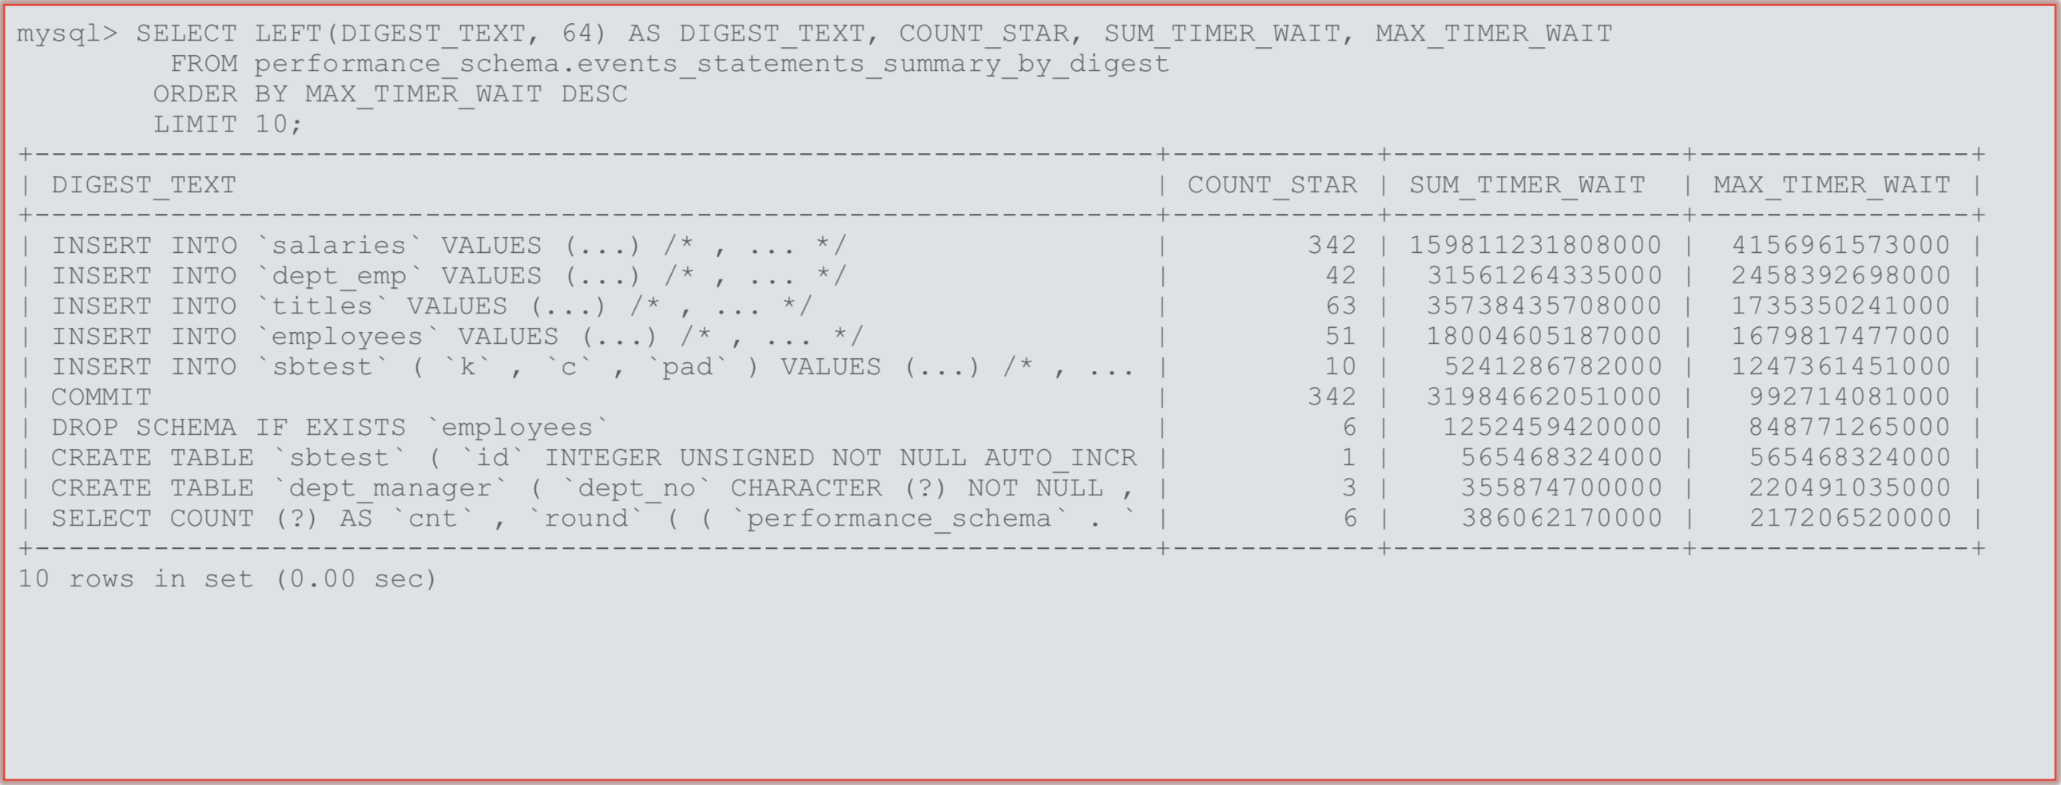
Query Tuning
Finding queries to optimize - Performance Schema Digest Summary

Slide 64
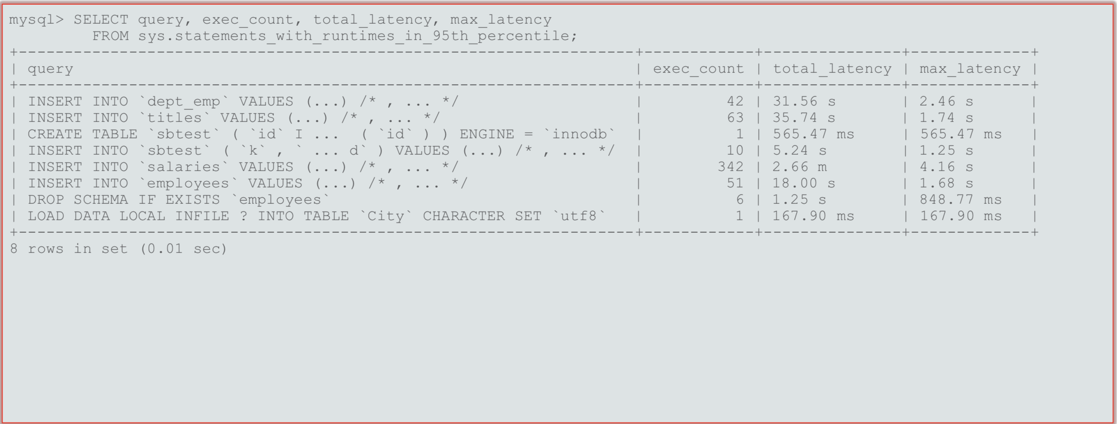
Query Tuning
Finding queries to optimize - 95th Percentile

Slide 65
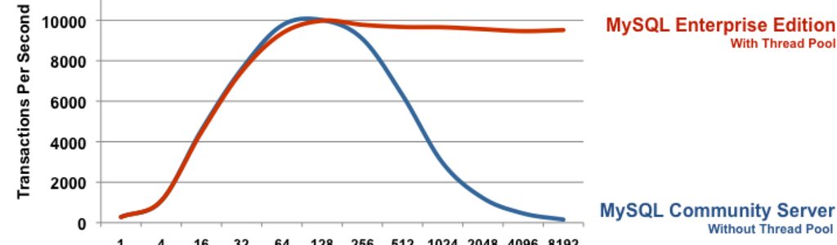
Enterprise Thread Pool
Part of Enterprise Edition features
Decoupling Connection Threads with CPU Threads by MySQL
Allows several connections for one execution threads
Decreases Context Switching
Stabilizes transactions per second in high concurrency systems
Useful to make Threads_running > number of hardware threads
Can also be used for mitigating the DOS attack

Slide 66
Tuning Thread Pool
thead_pool_size: number of threads in the pool, representing the actual threads processed by the CPU cores (default=16)
thread_pool_stall_limit: timeout before a thread is considered blocked and the thread pool can switch to other statement (default 60 ms).
The maximum number of threads in the system = max_connections + thread_pool_size
PERFORMANCE SCHEMA MONITORING:
tp_thread_group_state: information about thread pool thread group states
tp_thread_group_stats: information about thread pool thread group statistics
to_thread_state: thread pool thread state

Slide 67
Backup, Recovery, and Cloning

Slide 68
Logical Backup with MySQL Shell
Online, non-locking backup and recovery on InnoDB
Instance dump and Schema dump
Parallel threads and compression
Backup entire or selected database
Show progress of backup activity
Cloud backup to OCI Object Storage bucket
Compatible with MySQL 5.7 and above
Support “dryRun” mode to check and test without performing actual backup

Slide 69
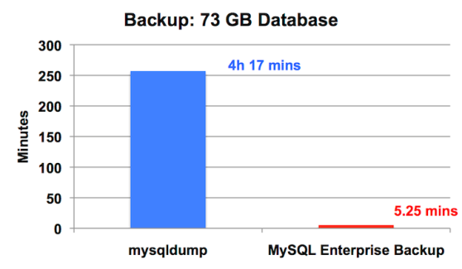
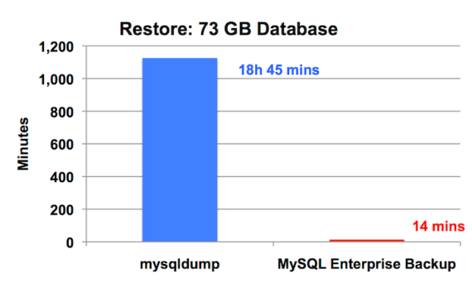
Physical Backup with MySQL Enterprise Backup
Online, non-locking backup and recovery
Complete MySQL instance backup (data and config)
Partial backup and restore
Incremental backups and Point-in-time recovery
Backup to tape (SBT)
Backup validation
Optimistic backups
Cross-Platform (Windows, Linux)

Slide 70
Database Backup (Oracle vs MySQL)
Function | Oracle | MySQL
Cold Backup (Offline) | Shutdown database Backup database files from OS Startup database | Shutdown database Backup database files from OS Startup database
Logical Backup / dump (Online) | exp: Export database (old version) expdmp: Export data pump (10g and above) | mysqldump, mysqlpump mysqlsh dumpInstance
Physical Backup (Online) | * Database must be in archive mode User Managed Backup: alter database begin backup Backup database files from OS alter database end backup System Managed Backup: Use Recovery Manager (RMAN) to backup database and archive logs | “User Managed Backup”: flush tables with read lock set global read_only=1 Backup database files from OS set global read_only=0 unlock tables ”System Managed Backup”: Use MySQL Enterprise Backup (MEB) to backup database files Backup Binlog from OS

Slide 71
Database Backup (Oracle vs MySQL)
Function | Oracle | MySQL
Incremental Backup | RMAN backup incremental level 0 (base) RMAN backup incremental level 1 (incremental base pointing to previous incremental backup) * Backup information is stored on database control files or RMAN catalog (if catalog is used) | MEB Incremental backup (by setting incremental base to last backup) * Backup information is stored on mysql.backup_history and mysql.backup_progress
Cumulative Backup | RMAN incremental backup level 1 cumulative (incremental base pointing to incremental level 0) | MEB differential backup (by setting incremental base to last full backup)

Slide 72
Archive log / Binlog Housekeeping
Function | Oracle | MySQL
From OS | Delete archive log from OS Run manually from RMAN to sync with control file or RMAN catalog (if used) RMAN > crosscheck archivelog all; | Delete Binlog from OS Edit Binlog index file using text editor and remove all deleted binlog
From Database Utility | Run manually from RMAN RMAN > delete noprompt archivelog all until time ‘<parameter>’ * RMAN delete archivelog all has any options | Run manually from mysql mysql > PURGE BINARY LOGS to ‘<parameter>’;
Scheduled Housekeeping | Run RMAN regularly to delete all expired archivelogs RMAN > delete noprompt expired archivelog all; | set system variable binlog_expire_logs_seconds

Slide 73
Database Recovery (Oracle vs MySQL)
Function | Oracle | MySQL
Restoration from Cold Backup | Restore database file startup nomount and recreate control file shutdown immediate and startup | Restore database file Startup database using Option file.
Restoration from Logical Backup | imp: Import database (old version) impdmp: Import data pump (10g and above) | Use mysql and source sql file mysqlsh loadDump
Restoration from Online backup | Using User Managed Backup: Restore database file startup nomount and recreate control file alter database mount recover database to do PITR alter database open resetlogs Using System Managed Backup: Use Recovery Manager (RMAN) to restore database, restore archive logs. and recover for PITR | “User Managed Backup”: Restore database file Startup database Use mysqlbinlog to apply Binlog for PITR ”System Managed Backup”: Use MySQL Enterprise Backup (MEB) to restore database files Start database Use mysqlbinlog to apply Binlog for PITR

Slide 74

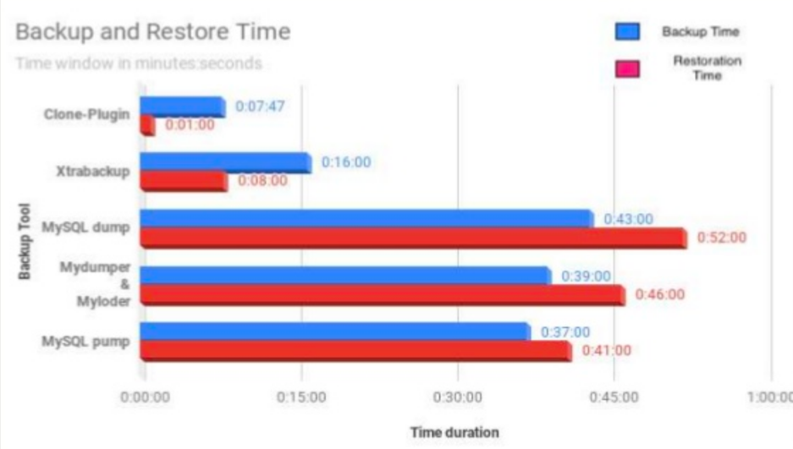
Cloning Database using Clone Plugin
Donor
Recipient
A better way to clone or migrate database
Simple way to create MySQL replicas
It’s easy to use with single SQL command
Data snapshot with consistent GTID and Binary Log position
Clone locally or from remote
It’s faster
2 servers @2c, 4 GB RAM, 200 GB SSD, 122 GB data from SysBench

Slide 75
Clone Database (Oracle vs MySQL)
Oracle | MySQL
RMAN Duplicate | Clone Plugin
RMAN Backup on source database Prepare target binary on target server Copy RMAN backup to target server | Install clone plugin on donor Grant BACKUP_ADMIN to user Install clone plugin on recipient Optionally grant CLONE_ADMIN to a user on recipient database
On target server: Startup nomount (target) Use RMAN, connect source database as TARGET and target database as AUXILIARY Run duplicate target database to AUX | From mysql CLI connecting to recipient: set CLONE_VALID_DONOR_LIST to allow donor host Run clone from target database

Slide 76
Transportable Tablespace (Oracle vs MySQL)
Method | Oracle | MySQL
Manual | On sour Check if tablespace is self-contained Alter tablespace read only Export metadata Copy database file to target location via OS command Alter tablespace read write On target: Import metadata Alter tablespace read write | INNODB_FILE_PER_TABLE must be enabled No foreign key, or else foreign_key_check must be disab On target: Create table engine=InnoDB Alter table discard tablespace On source: Flush table for export Copy database file to target location via OS command Unlock tables On target: Alter table import tablespace
System | Using RMAN Transportable Tablespace: https://docs.oracle.com/en-us/iaas/Content/Database/Tasks/mig-rman-transp-tablespace.htm | Using MEB Transportable Tablespace: https://dev.mysql.com/doc/mysql-enterprise-backup/8.0/en/restore-use-tts.html

Slide 77
MySQL Database Security

Slide 78
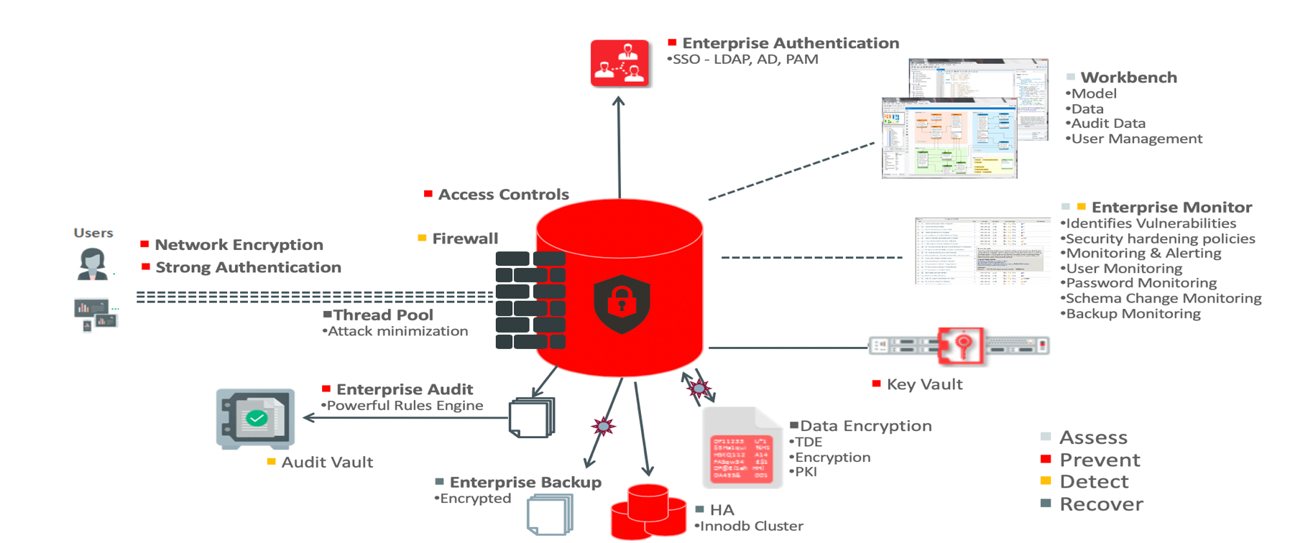
MySQL Enterprise Edition Security Architecture
Notes:
MySQL is an integral part of our lives. Whether you are checking in on social media, watching an online video, hailing an Uber, booking a hotel or a B&B, storing files, using your mobile phone, its highly likely you are viewing pages served up by a MySQL server.
It’s likely also the case when you are playing or betting online, or managing your personal finances with web-based tools. And you’re again relying on MySQL when making mobile payments via square, buying shoes, clothes and many other items at Zappos (perhaps more for women in the audience :)), and searching for events tickets at Ticketmaster.
MySQL is just about everywhere!
Those organizations, including many digital disruptors, chose MySQL for 2 key reasons: because it allows them to rapidly innovate, and because it is a proven and battle-tested technology that helps them ensure the reliability of their services.
As a matter of fact....(link to next slide)

Slide 79
Data In-Transit Encryption
MySQL provides network encryption (SSL/TLS and Native) to encrypt all traffic from the MySQL Clients
Users can be restricted to the use of SSL enabled connections to ensure use of strong cryptography for their network connection.
MySQL 8.0, caching_sha2_password as default
Support encrypted connection (default) that use TLS, and the password (even it is sent as clear text) can’t be snooped. Password is never exposed as clear-text when connecting to server
Support unencrypted connection (--ssl-mode=DISABLED), but the password will be encrypted using RSA key-pair when connecting to server
sha256_password_auto_generate_rsa_keys (default: ON)
sha256_password_private_key_path
sha256_password_public_key_path

Slide 80
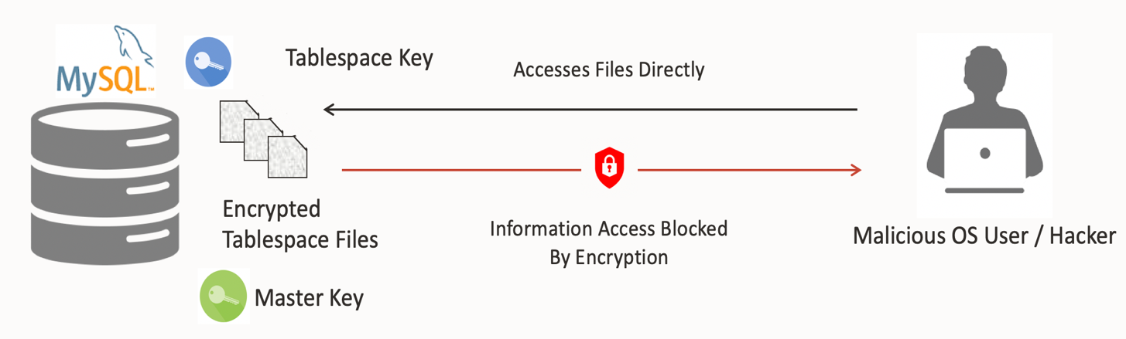
Data At-Rest Encryption with MySQL Transparent Data Encryption
Encrypting physical files of the database on disk using industry standard AES algorithm
Data is encrypted automatically in real time prior writing to storage and decrypted when read from storage
InnoDB supports data-at-rest encryption for file-per-table tablespaces, general tablespaces, the mysql system tablespace, redo logs, binary logs, relay logs, and undo logs.
Hackers and malicious users are unable to read sensitive data from tablespace files.

Slide 81


Transparent Data Encryption Architecture
2 Tier Architecture
Key Vault
MySQL Server
Client
Plugin & Services Infrastructure
Master Key
Stored outside the database
Oracle Key Vault
KMIP 1.1 Compliant Key Vault
Tablespace Key
Protected by master key
Master Key
Keyring plugins
MySQL Database
Tablespace Keys
InnoDB
Plain Text
Encrypted 1
Encrypted 2
Two tier encryption key architecture (a master key and tablespace keys)
Secure cryptographic key with Oracle Key Vault, KMIP 1.1 Compliant, etc.
Support cryptographic key change (with master key rotation is atomic, instance-level operation)

Slide 82
User Accounts
 | Oracle Database | MySQL Server
Built-in Account | SYS, SYSTEM, others | root
User Account | User name | User Name @ Host
Privileges Handling | GRANT, REVOKE | GRANT, REVOKE
Privilege Granularity | Column, Row (with OLS) | Column
Group Management | ROLE | ROLE
SSL Support | Yes | Yes
Encryption | Transparent, RC4, DES, AES, etc. | Transparent, AES256, DES
Authentication | OS, DB, LDAP, Kerberos | OS, DB, LDAP, Kerberos

Slide 83
MySQL Roles
A role is basically a user account with login disabled (locked and no privileges)
Improving MySQL Access Controls
Easier to manage user and applications rights
As standards compliant as practically possible
Multiple default roles
2 new tables: mysql.role_edges and mysql.default_roles
SQL functions: CURRENT_ROLE()
3 new global privileges: CREATE ROLE, DROP ROLE and ROLE_ADMIN
Extensions to: ALTER USER, GRANT/REVOKE, SET and SHOW GRANTS

Slide 84
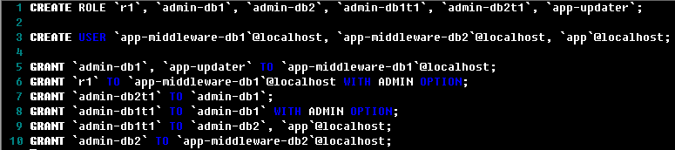
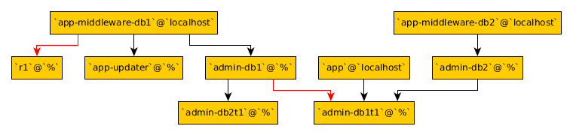
MySQL Roles Example

Slide 85
MySQL Password Validation Plugin
The Password validation plugin serves to test passwords and improve security.
It exposes a set of system variables that enable to define password policy.
the plugin checks the password against the current password policy and rejects it if it is weak.
mysql > install plugin validate_password soname ‘validate_password.so’;
New System Variables
VALIDATE_PASSWORD_LENGTH (default: 8)
VALIDATE_PASSWORD_MIXED_CASE_COUNT (default: 1)
VALIDATE_PASSWORD_CHECK_USER_NAME (default: ON)
VALIDATE_PASSWORD_NUMBER_COUNT (default: 1)
VALIDATE_PASSWORD_SPECIAL_CHAR_COUNT (default: 1)
VALIDATE_PASSWORD_DICTIONARY_FILE
VALIDATE_PASSWORD_POLICY (LOW | MEDIUM | STRONG)

Slide 86
Password Expiry and Reuse Policy
System Variables | Description
PASSWORD_LIFETIME | determine amount of days it takes before a password can be auto-expired
PASSWORD_REUSE_HISTORY | determines number of distinct password set before a password can be reused
PASSWORD_REUSE_TIME | determines amount of days it takes before a password can be reused

Slide 87
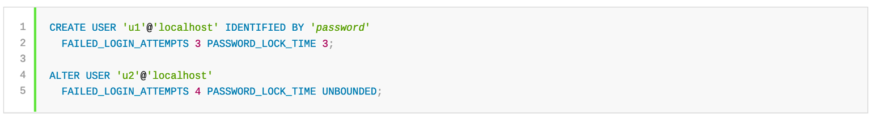
Failed Login Tracking and Temporary Account Locking
As of MySQL 8.0.19, administrators can configure user accounts such that too many consecutive login failures cause temporary account locking.
Reset by restarting MySQL server or DBA intervention to UNLOCK
System Variables | Description
FAILED_LOGIN_ATTEMPS | How many consecutive incorrect password caused temporary account locking
PASSWORD_LOCK_TIME | The number of days the account remains unlocked

Slide 88
Random Password and Dual Password
Dual password is designated as primary and secondary passwords. Dual-password capability makes it possible to seamlessly perform credential changes
alter user demo@'%' identified by ‘123' retain current password;
alter user demo@'%' discard old password;
As of MySQL 8.0.18, the CREATE USER, ALTER USER, and SET PASSWORD statements have the capability of generating random passwords for user accounts, as an alternative to requiring explicit administrator-specified literal passwords.
mysql> create user uat@'%' identified by random password;
+------+------+------------------------+
| user | host | generated password |
+------+------+------------------------+
| uat | % | nPx>XM{g5ibH1M__xEaP |
+------+------+------------------------+
1 row in set (0.00 sec)

Slide 89
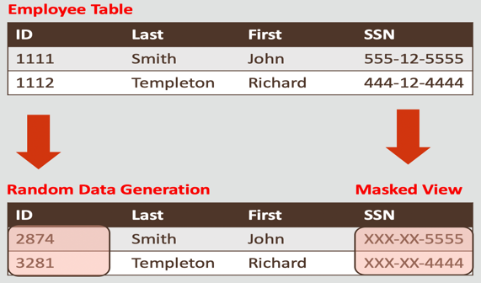
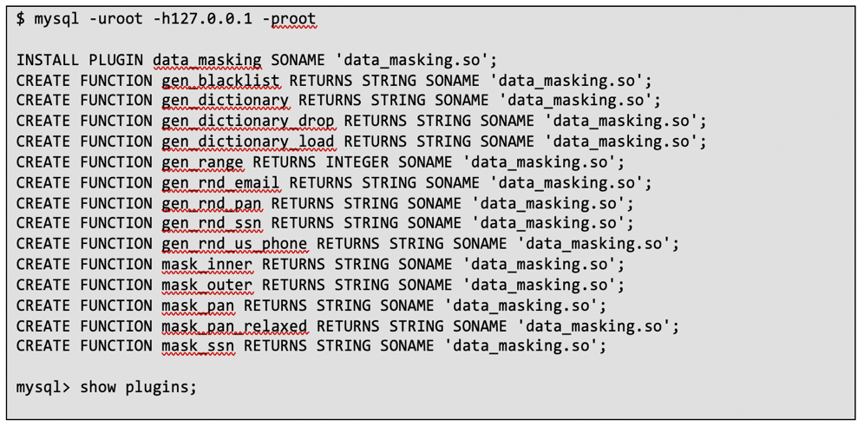
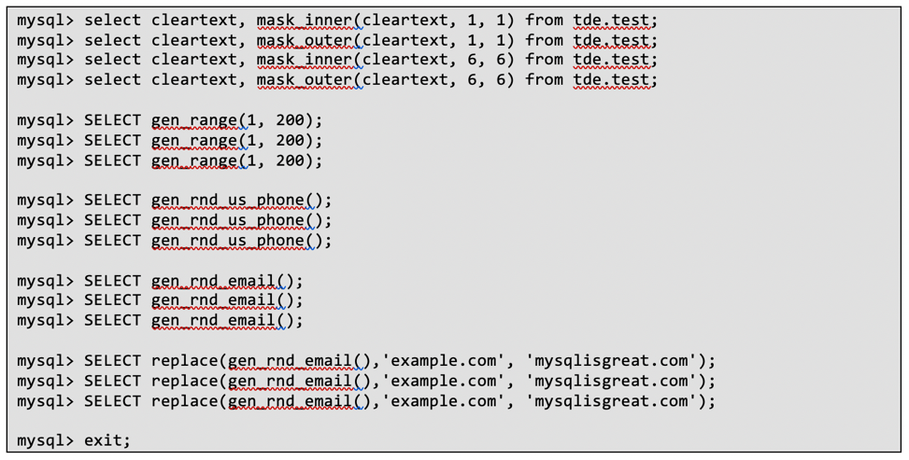
MySQL Enterprise Data Masking and De-identification
Data Masking simply replaces real value with false value, keeping the data format.
Data Masking and De-Identification replaces credit card values and cardholder information with realistic, but false values

Slide 90
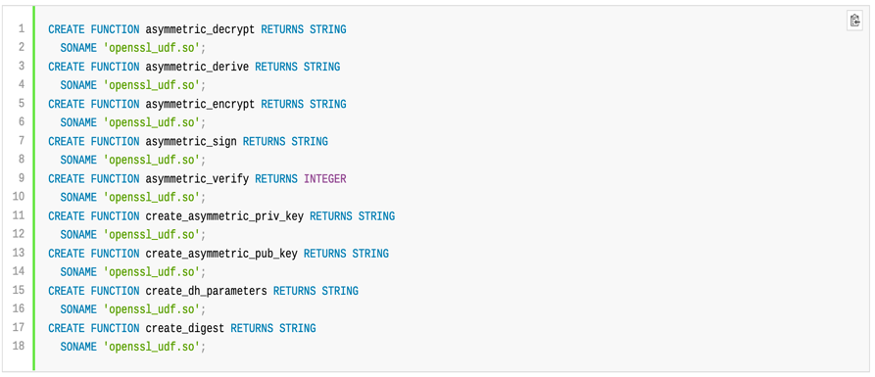
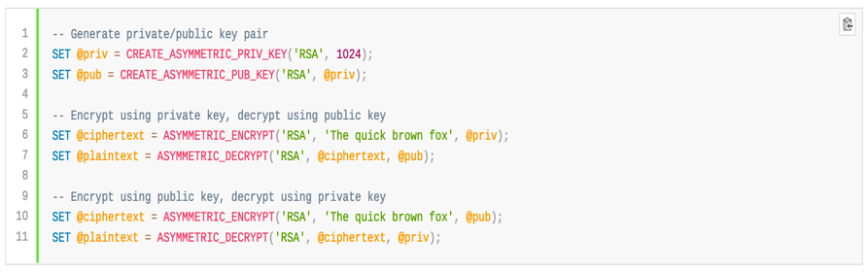
MySQL Enterprise Encryption
What it does | Function and Capabilities
Secure data using combination of public, private, and symmetric keys to encrypt/decrypt Encrypt data stored using RSA, DSA, or DH encryption Protect replicated data by encrypting Binlog Eliminate unnecessary exposure to data Interoperate with other cryptographic systems and appliance Avoid exposure of asymmetric keys within client application or on disk | Asymmetric Public Key Encryption (RSA) Asymmetric Private Key Encryption (RSA) Generate Public/Private key Decryption (RSA, DSA, DH) Derive symmetric keys from Public and Private keys (DG) Digitally sign data (RSA, DSA) Verify data signature (RSA, DSA) Validation Data Authenticity (RSA, DSA) Enable software developers to encrypt data
Installation
Sample (asymmetric encryption)

Slide 91
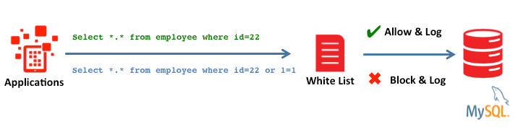
MySQL Enterprise Firewall
Records whitelists of SQL statements
Dynamic plug-in
Real-time threat monitoring
Transparent to application
Logging of statements

Slide 92
The Firewall Concept
Receive SQL from client
Digest into parser tokens
Firewall
Store SQL digest in Firewall whitelist
Recording
Check user Firewall mode
Off
Protect or Detect
Yes
In whitelist?
MySQL Enterprise Firewall Workflow
No
Send
Firewall alert to
error log
Detect
Detect or protect mode
Protect
Execute SQL
Reject SQL
Notes:
List of Industry;
Aerospace & Defense
Automotive
Chemicals
Communications
Consumer Goods
Engineering & Construction
High Technology
Industrial Manufacturing
Life Sciences
Media & Entertainment
Natural Resources
Oil & Gas
Professional Services
Retail
Travel & Transportation
Utilities
Wholesale Distribution

Slide 93
MySQL Enterprise Audit
MySQL Enterprise Audit provides quickly and seamlessly add policy-based auditing compliance to PCI Applications.
Fine grain auditing, dynamic configurable tracking of user level activity
Filter on connections, users, table access, access type, statement status (success / failure), query content, and more.
XML-based audit stream using:
NEW: XML format compatible with Oracle Audit Vault
OLD: XML only
JSON: log audit in JSON format, support MySQL API to read audit log

Slide 94
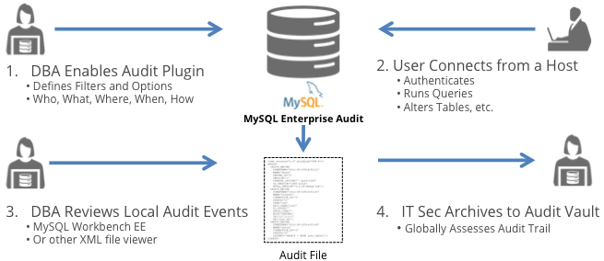
MySQL Enterprise Audit Concept

Slide 95
MySQL Replication and InnoDB Cluster

Slide 96
High availability configuration
 | Oracle Database | MySQL Server
Replication | Oracle Streams Oracle Golden Gate Logical Standby Data Guard Physical Standby Data Guard Active Data Guard | Oracle Golden Gate MySQL Async. Replication MySQL Semi-sync Replication MySQL InnoDB Replica Set MySQL Group Replication
Shared disk type Active-Active cluster | Oracle Real Application Clusters (RAC) | N/A
Shared disk type Active-Passive cluster | Oracle Real Application Clusters (RAC) One Node | Active-Passive using Oracle Clusterware
Shared-nothing type Active-Active cluster | Oracle Golden Gate | MySQL NDB Cluster, MySQL InnoDB Cluster

Slide 97

MySQL Asynchronous Replication
Source
Replica
I/O
Database
Database
I/O
SQL
MySQL
Transactions
SQL
Binary Log
Relay Log
Binary Log

Slide 98
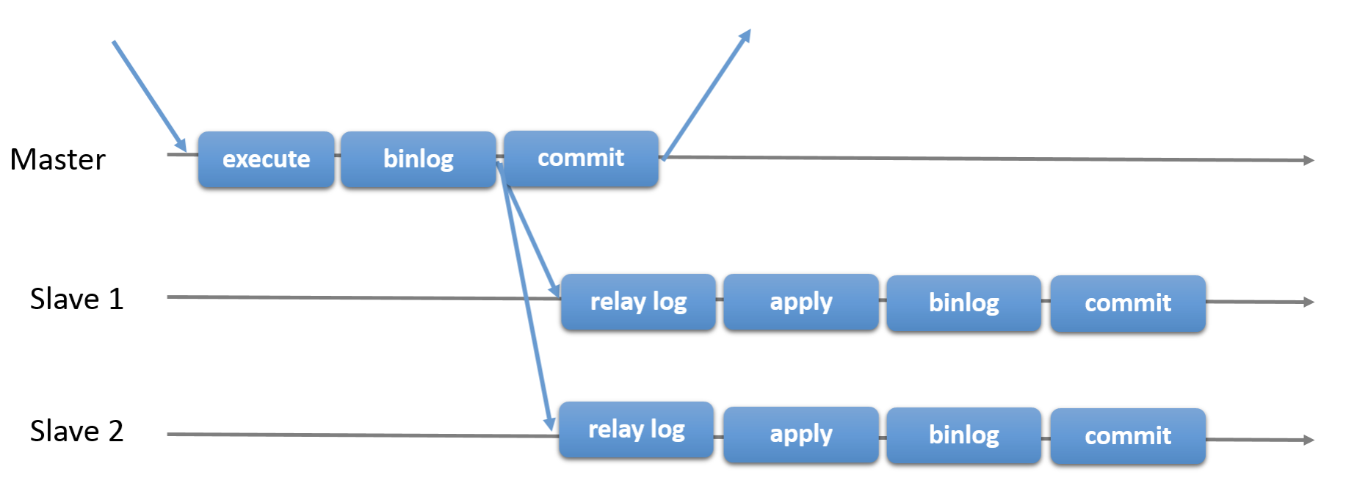
How MySQL Replication works
Source
Replica
Replica
Traditional MySQL Asynchronous Source / Replica
Copyright © 2020 Oracle and/or its affiliates.
Notes:
- As many of you in this room would probably know, MySQL has proven itself to be the best open-source solution for OLTP.
The topic of this talk is; how can one run real-time and high-performance Analytics over the same transactional store?
While MySQL provides high throughput for insert/update-intensive workloads, it is not well suited for plowing through large amounts of data for Analytics processing. And also, running both OLTP and Analytics on the same resources introduces complexity to balance the computational requirements of the two.
The alternative is to run Analytics outside of MySQL, either on-prem or in the cloud. Both require maintaining two separate systems; one for OLTP, one for Analytics, and migrating data from MySQL to Analytics and preclude real-time Analytics on the transactional store, provided by MySQL.

Slide 99
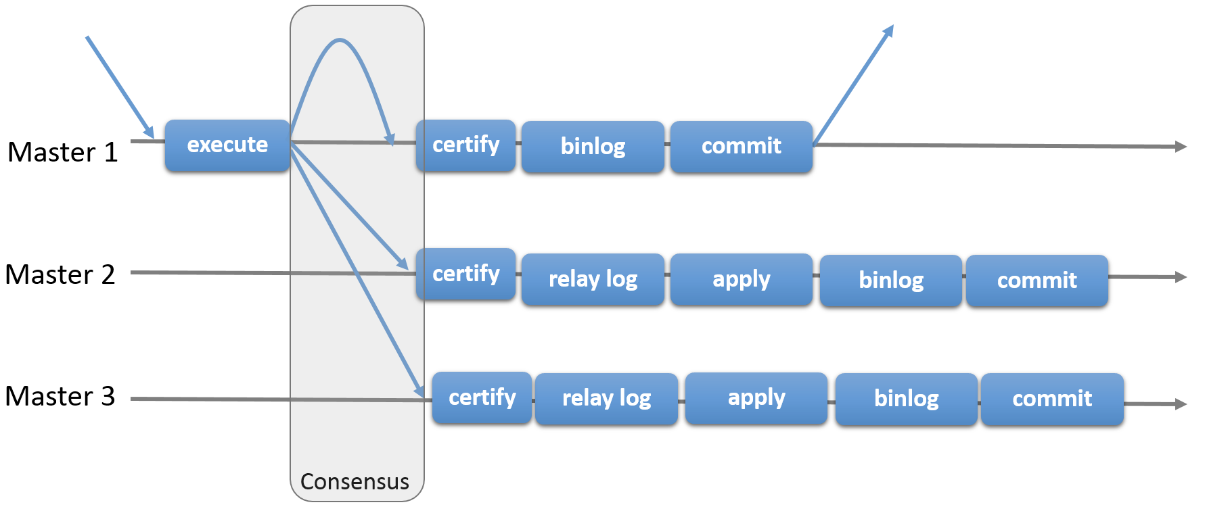
How Group Replication Works
Primary
Secondary
Secondary
Group Replication Protocol - first transaction that commit ”wins”
Copyright © 2020 Oracle and/or its affiliates.
Notes:
- As many of you in this room would probably know, MySQL has proven itself to be the best open-source solution for OLTP.
The topic of this talk is; how can one run real-time and high-performance Analytics over the same transactional store?
While MySQL provides high throughput for insert/update-intensive workloads, it is not well suited for plowing through large amounts of data for Analytics processing. And also, running both OLTP and Analytics on the same resources introduces complexity to balance the computational requirements of the two.
The alternative is to run Analytics outside of MySQL, either on-prem or in the cloud. Both require maintaining two separate systems; one for OLTP, one for Analytics, and migrating data from MySQL to Analytics and preclude real-time Analytics on the transactional store, provided by MySQL.

Slide 100
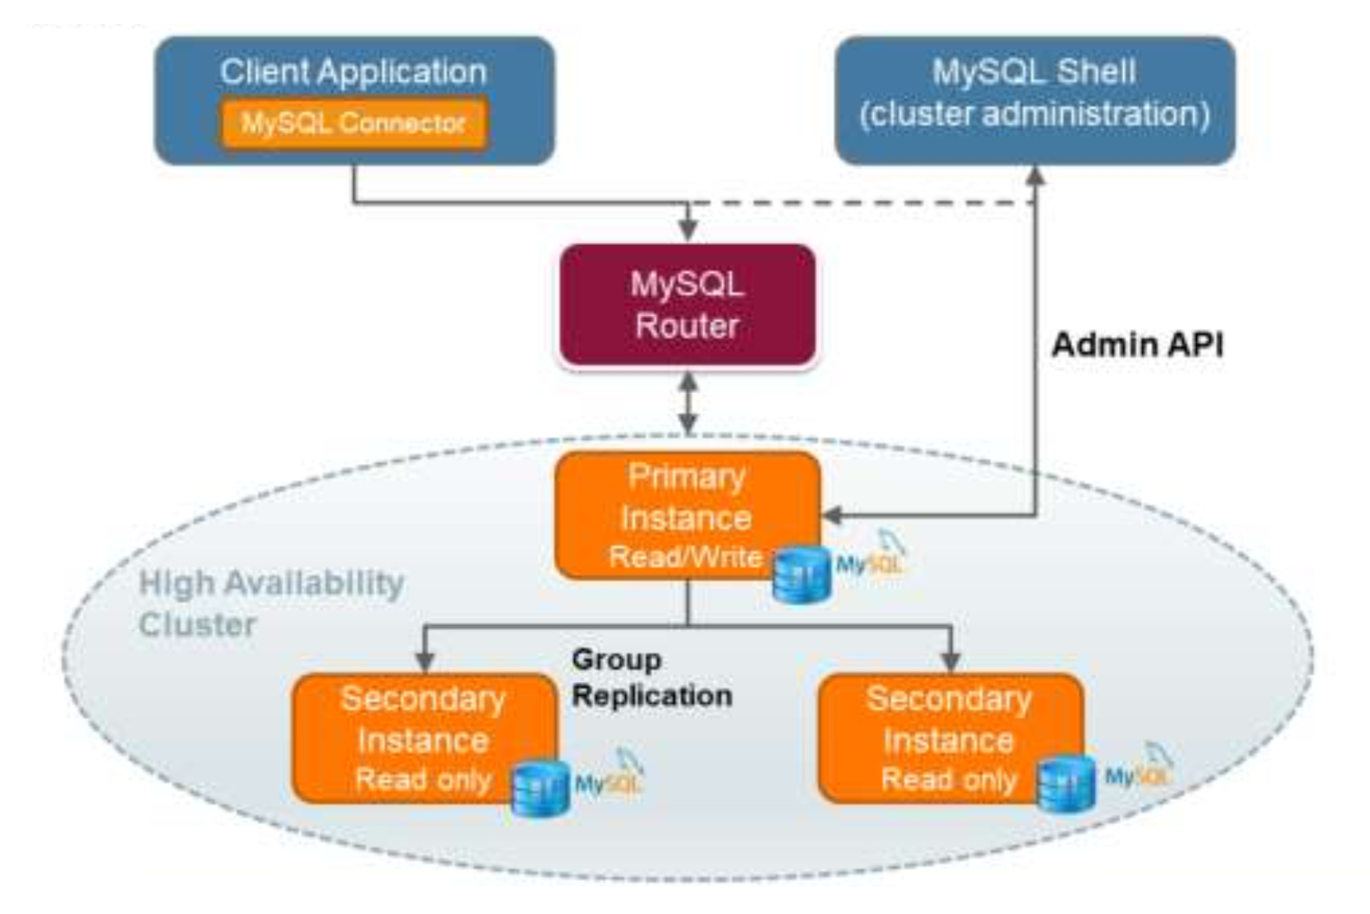
InnoDB Cluster - High Level Architecture
Group Replication
Copyright © 2020 Oracle and/or its affiliates.
Notes:
- As many of you in this room would probably know, MySQL has proven itself to be the best open-source solution for OLTP.
The topic of this talk is; how can one run real-time and high-performance Analytics over the same transactional store?
While MySQL provides high throughput for insert/update-intensive workloads, it is not well suited for plowing through large amounts of data for Analytics processing. And also, running both OLTP and Analytics on the same resources introduces complexity to balance the computational requirements of the two.
The alternative is to run Analytics outside of MySQL, either on-prem or in the cloud. Both require maintaining two separate systems; one for OLTP, one for Analytics, and migrating data from MySQL to Analytics and preclude real-time Analytics on the transactional store, provided by MySQL.

Slide 101
Shared Nothing Cluster
All nodes have sole access to distinct disk with sole responsibility for the data it holds
Each cluster members have its own database and completely have autonomy over it
Rely solely on network connections between cluster members to maintain cluster and data integrity
Copyright © 2020 Oracle and/or its affiliates.
Notes:
- As many of you in this room would probably know, MySQL has proven itself to be the best open-source solution for OLTP.
The topic of this talk is; how can one run real-time and high-performance Analytics over the same transactional store?
While MySQL provides high throughput for insert/update-intensive workloads, it is not well suited for plowing through large amounts of data for Analytics processing. And also, running both OLTP and Analytics on the same resources introduces complexity to balance the computational requirements of the two.
The alternative is to run Analytics outside of MySQL, either on-prem or in the cloud. Both require maintaining two separate systems; one for OLTP, one for Analytics, and migrating data from MySQL to Analytics and preclude real-time Analytics on the transactional store, provided by MySQL.

Slide 102

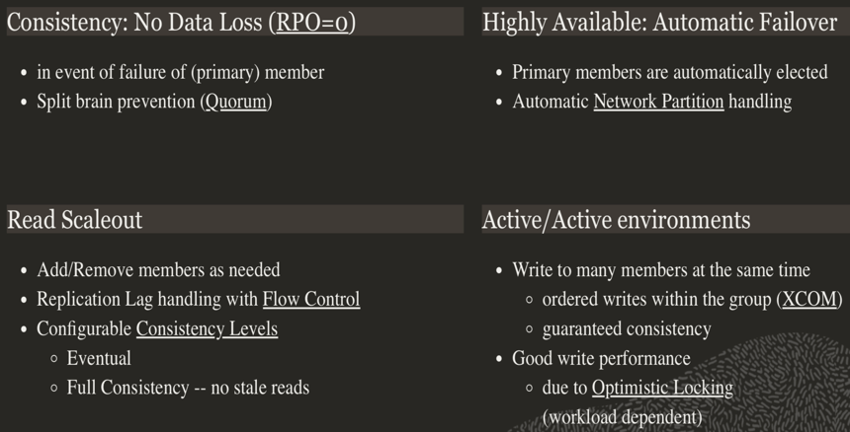
What is MySQL Group Replication
“Group Replication is a plugin for high availability using InnoDB storage Engine. In a nutshell, a vanilla group replication is the core high availability engine of InnoDB Cluster”

Slide 103
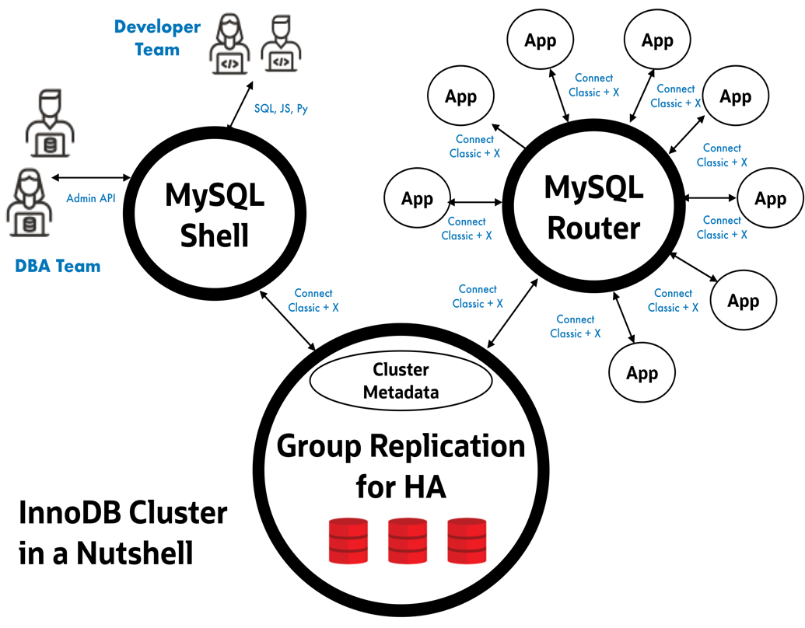
What is MySQL InnoDB Cluster
“A single product - MySQL - with high availability
and scaling features baked in: providing an integrated end to end solution that is easy to use”

Slide 104
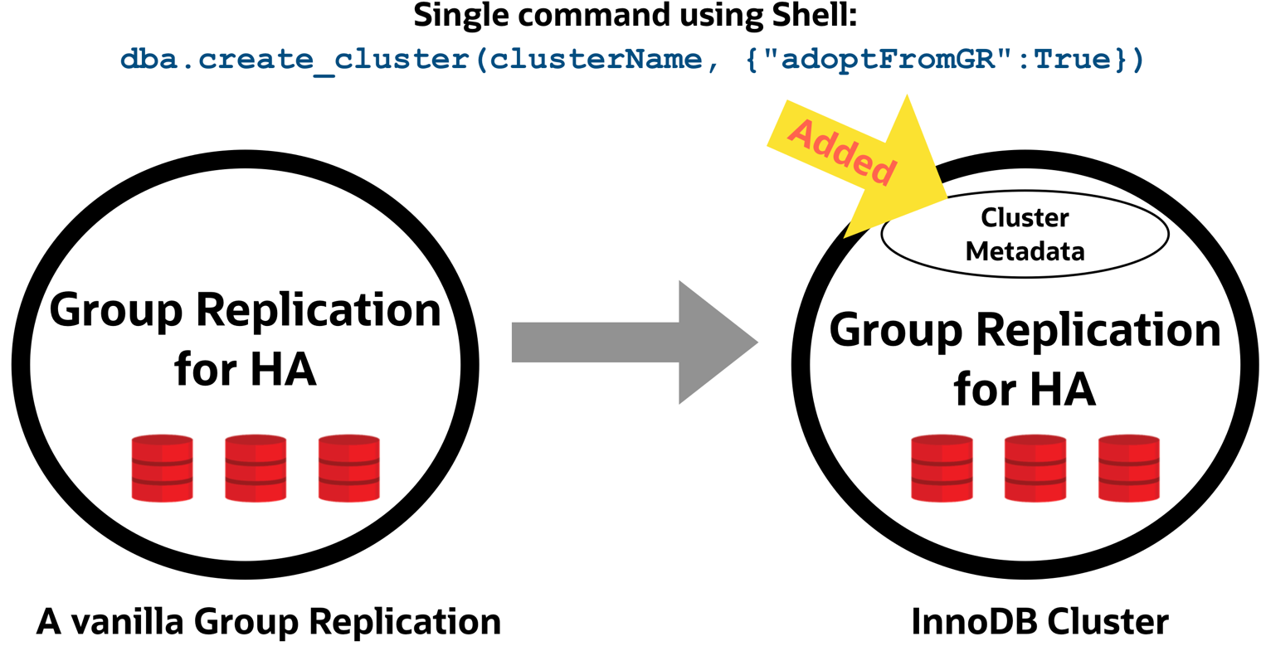
Converting a Group Replication to InnoDB Cluster is easy and fast!
CONVERSION !

Slide 105
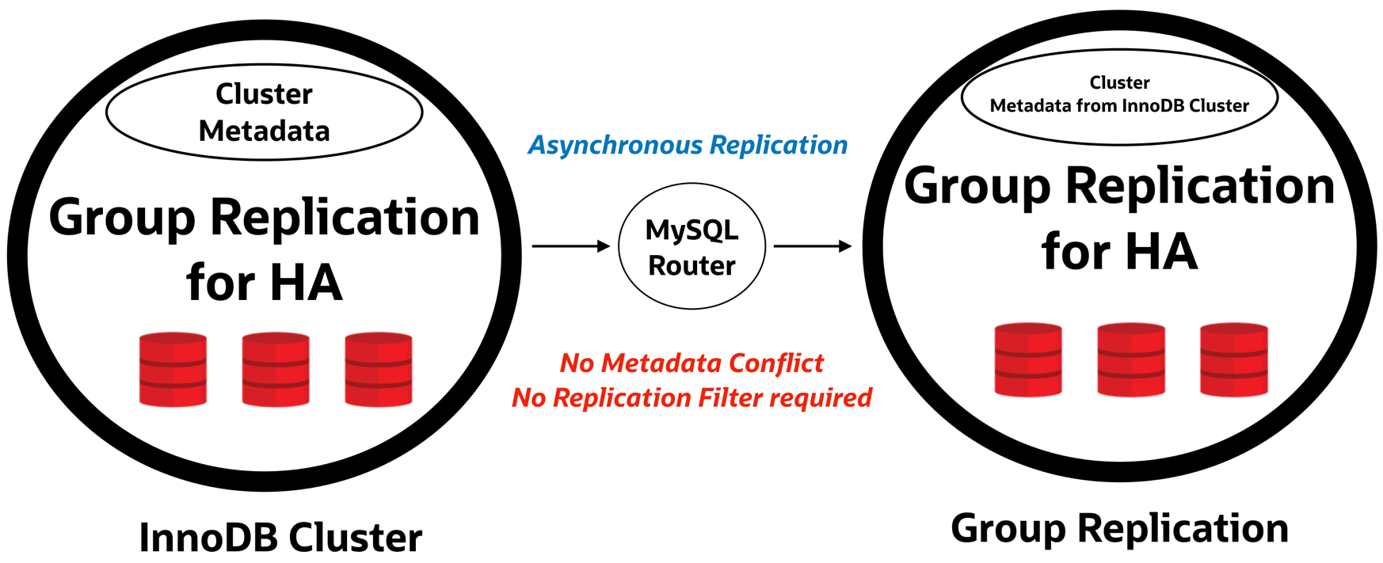
InnoDB Cluster and Group Replication are compatible
REPLICATION !
“recent shell release does not compatible with replication filter”

Slide 106
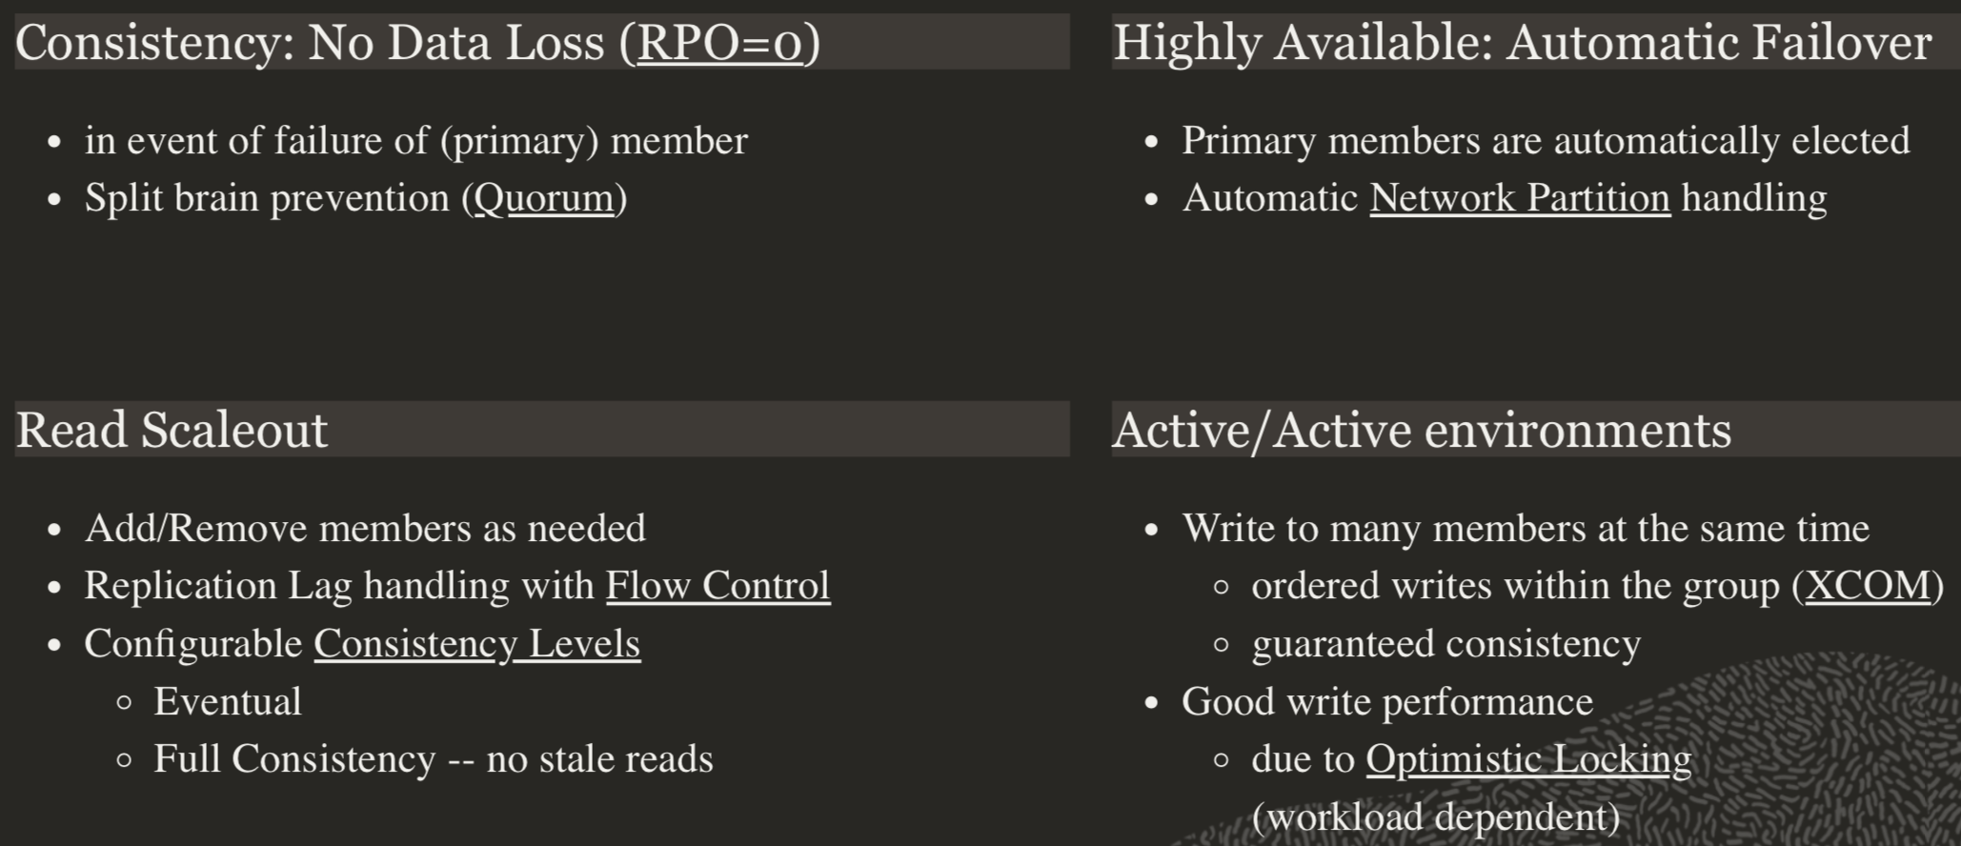
InnoDB Cluster Used Cases
Copyright © 2020 Oracle and/or its affiliates.
Notes:
- As many of you in this room would probably know, MySQL has proven itself to be the best open-source solution for OLTP.
The topic of this talk is; how can one run real-time and high-performance Analytics over the same transactional store?
While MySQL provides high throughput for insert/update-intensive workloads, it is not well suited for plowing through large amounts of data for Analytics processing. And also, running both OLTP and Analytics on the same resources introduces complexity to balance the computational requirements of the two.
The alternative is to run Analytics outside of MySQL, either on-prem or in the cloud. Both require maintaining two separate systems; one for OLTP, one for Analytics, and migrating data from MySQL to Analytics and preclude real-time Analytics on the transactional store, provided by MySQL.

Slide 107
InnoDB Cluster Requirements
InnoDB Storage Engine
Primary Keys
GTID’s
Stable/High network performance/low latency
Binary log active
--log-bin[=log_file_name]
Slave updates logged
--log-slave-updates
Binary log row format
--binlog-format=row
Global transaction identifiers enabled (on)
--gtid-mode=ON
Replication information (metadata) repositories
--master-info-repository=TABLE
--relay-log-info-repository=TABLE
Copyright © 2020 Oracle and/or its affiliates.
Notes:
- As many of you in this room would probably know, MySQL has proven itself to be the best open-source solution for OLTP.
The topic of this talk is; how can one run real-time and high-performance Analytics over the same transactional store?
While MySQL provides high throughput for insert/update-intensive workloads, it is not well suited for plowing through large amounts of data for Analytics processing. And also, running both OLTP and Analytics on the same resources introduces complexity to balance the computational requirements of the two.
The alternative is to run Analytics outside of MySQL, either on-prem or in the cloud. Both require maintaining two separate systems; one for OLTP, one for Analytics, and migrating data from MySQL to Analytics and preclude real-time Analytics on the transactional store, provided by MySQL.

Slide 108
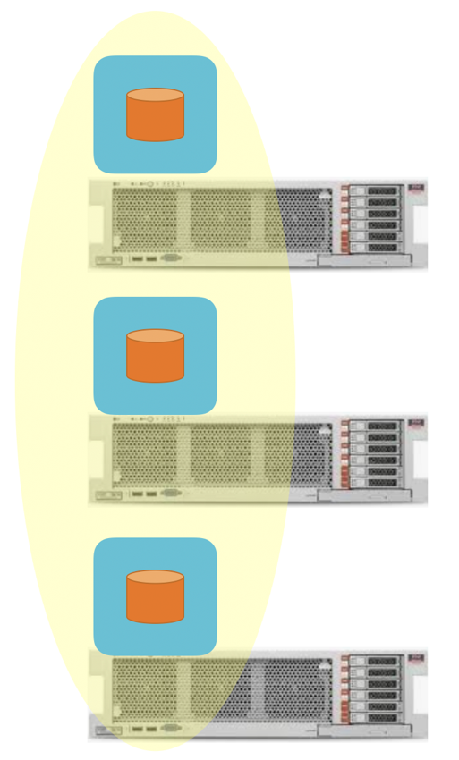
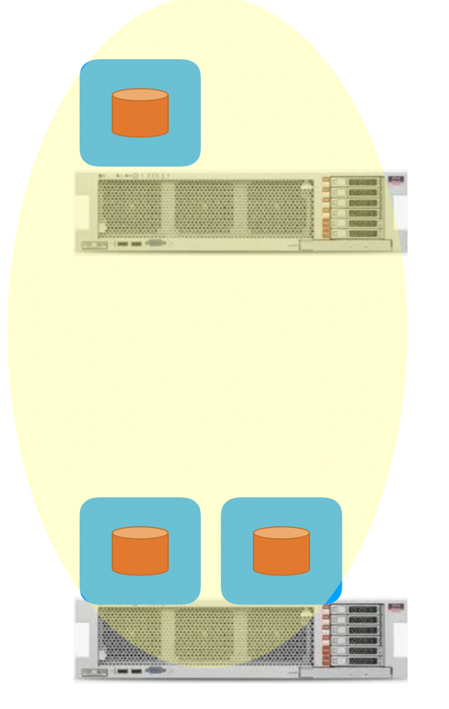
InnoDB Cluster Deployment
database 1
database 1
CORRECT
Vs.
WRONG
database 2
database 2
database 3
database 3
Copyright © 2020 Oracle and/or its affiliates.
Notes:
- As many of you in this room would probably know, MySQL has proven itself to be the best open-source solution for OLTP.
The topic of this talk is; how can one run real-time and high-performance Analytics over the same transactional store?
While MySQL provides high throughput for insert/update-intensive workloads, it is not well suited for plowing through large amounts of data for Analytics processing. And also, running both OLTP and Analytics on the same resources introduces complexity to balance the computational requirements of the two.
The alternative is to run Analytics outside of MySQL, either on-prem or in the cloud. Both require maintaining two separate systems; one for OLTP, one for Analytics, and migrating data from MySQL to Analytics and preclude real-time Analytics on the transactional store, provided by MySQL.

Slide 109
InnoDB Cluster Deployment
Survive
database 1
NOT Survive
database 1
Survive
Vs.
database 2
database 2
database 3
database 3
Copyright © 2020 Oracle and/or its affiliates.
Notes:
- As many of you in this room would probably know, MySQL has proven itself to be the best open-source solution for OLTP.
The topic of this talk is; how can one run real-time and high-performance Analytics over the same transactional store?
While MySQL provides high throughput for insert/update-intensive workloads, it is not well suited for plowing through large amounts of data for Analytics processing. And also, running both OLTP and Analytics on the same resources introduces complexity to balance the computational requirements of the two.
The alternative is to run Analytics outside of MySQL, either on-prem or in the cloud. Both require maintaining two separate systems; one for OLTP, one for Analytics, and migrating data from MySQL to Analytics and preclude real-time Analytics on the transactional store, provided by MySQL.

Slide 110
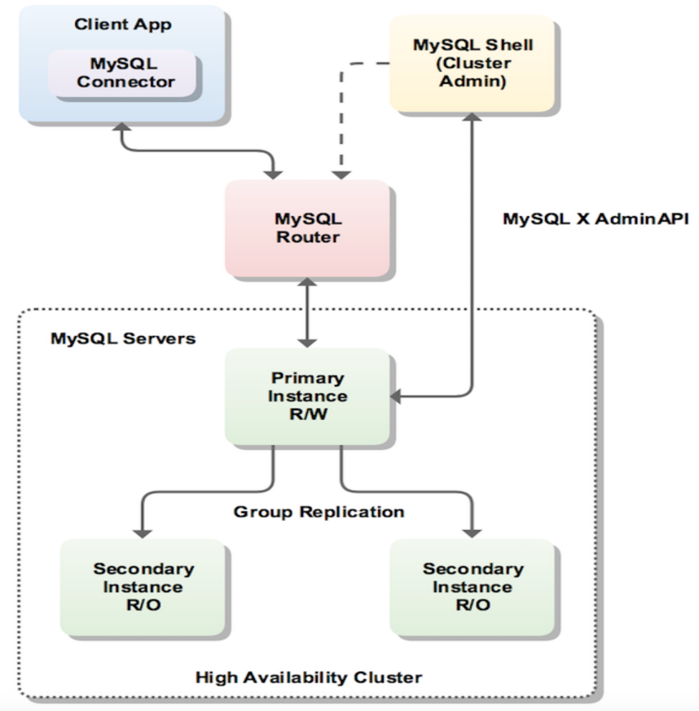
Why use MySQL Router
Lightweight middleware
Provide Application Connection Transparency
Application connects to MySQL Router
Manage failover by automatically routing connection using Load Balancing policies
Distribute connections to database across pool of servers for performance and scalability
Pluggable architecture - developers can extend by creating custom plugins for specific use cases.
R/W Port (6446, 64460) to automatically re-route connection to Primary member (R/W, DML, Query)
R/O Port (6447, 64470) to automatically re-route connection to Secondary member (R/O, Query only)
Copyright © 2020 Oracle and/or its affiliates.
Notes:
- As many of you in this room would probably know, MySQL has proven itself to be the best open-source solution for OLTP.
The topic of this talk is; how can one run real-time and high-performance Analytics over the same transactional store?
While MySQL provides high throughput for insert/update-intensive workloads, it is not well suited for plowing through large amounts of data for Analytics processing. And also, running both OLTP and Analytics on the same resources introduces complexity to balance the computational requirements of the two.
The alternative is to run Analytics outside of MySQL, either on-prem or in the cloud. Both require maintaining two separate systems; one for OLTP, one for Analytics, and migrating data from MySQL to Analytics and preclude real-time Analytics on the transactional store, provided by MySQL.

Slide 111
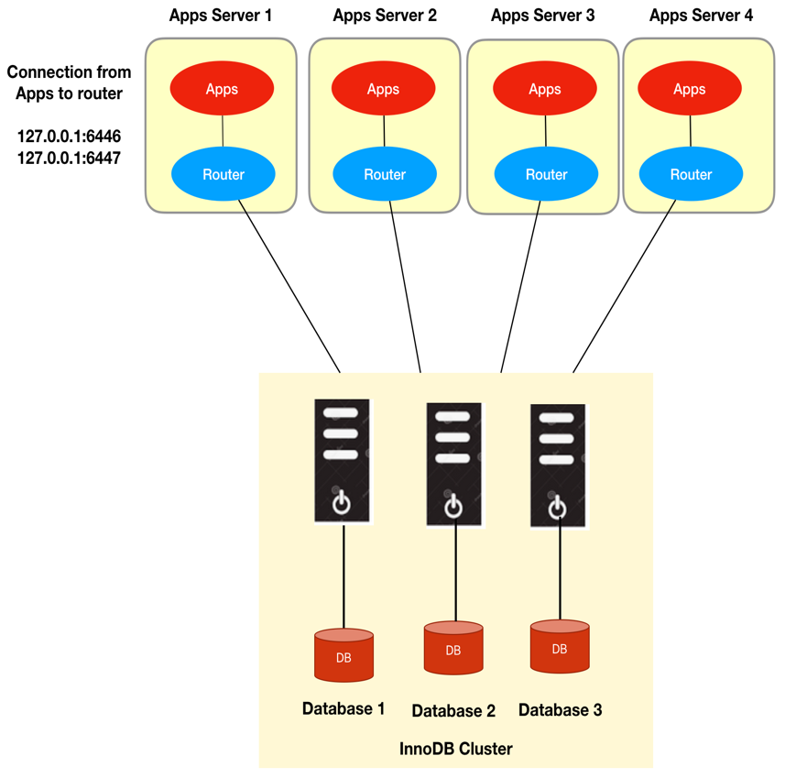
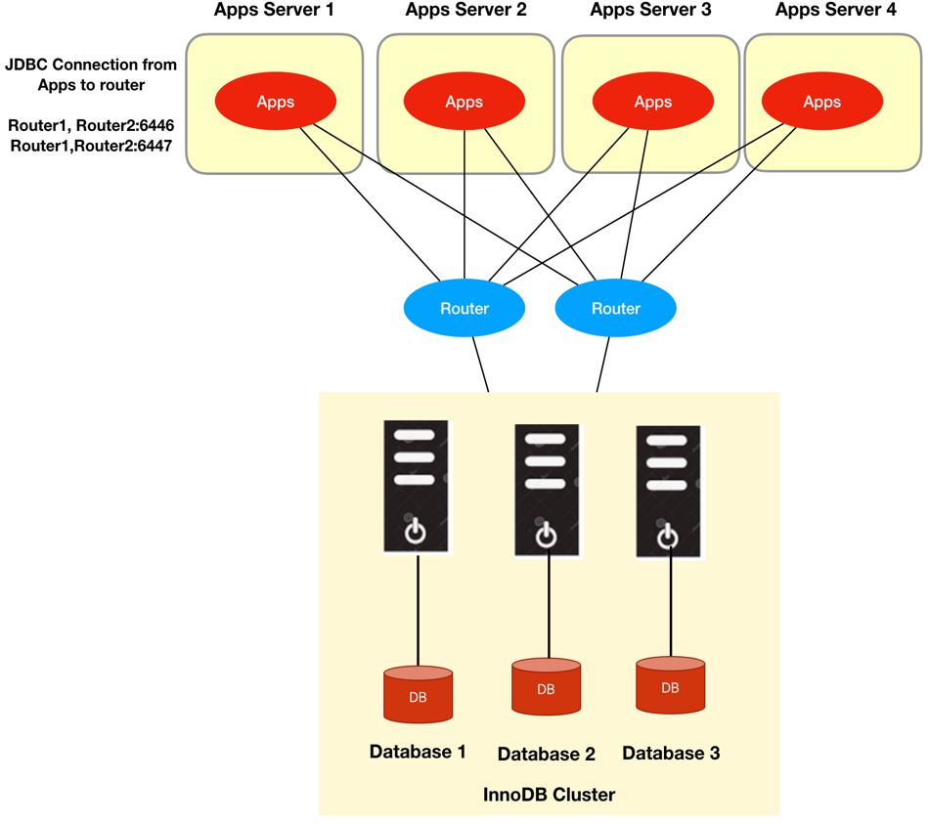
MySQL Router Deployment
Vs.
Copyright © 2020 Oracle and/or its affiliates.
Notes:
- As many of you in this room would probably know, MySQL has proven itself to be the best open-source solution for OLTP.
The topic of this talk is; how can one run real-time and high-performance Analytics over the same transactional store?
While MySQL provides high throughput for insert/update-intensive workloads, it is not well suited for plowing through large amounts of data for Analytics processing. And also, running both OLTP and Analytics on the same resources introduces complexity to balance the computational requirements of the two.
The alternative is to run Analytics outside of MySQL, either on-prem or in the cloud. Both require maintaining two separate systems; one for OLTP, one for Analytics, and migrating data from MySQL to Analytics and preclude real-time Analytics on the transactional store, provided by MySQL.

Slide 112
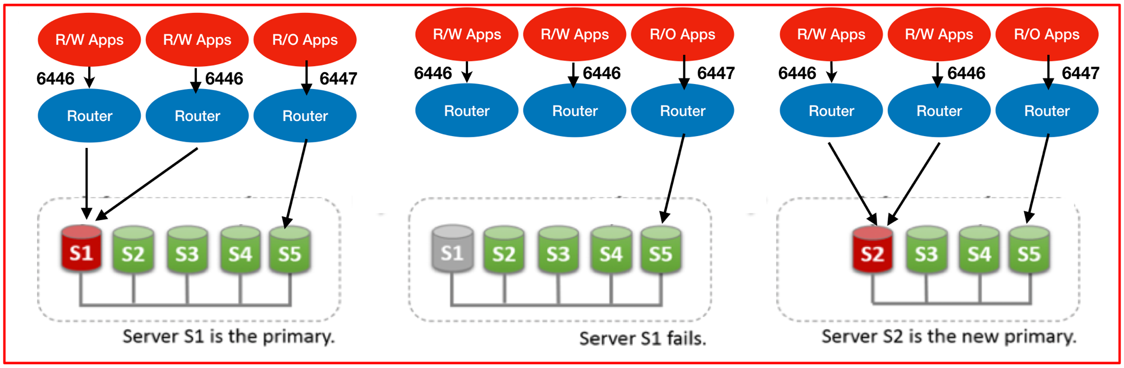
InnoDB Cluster (general purpose DB cluster)
Round Robin
to secondary
Round Robin
to secondary
Round Robin
to secondary
Point to Primary
Point to New Primary

Slide 113
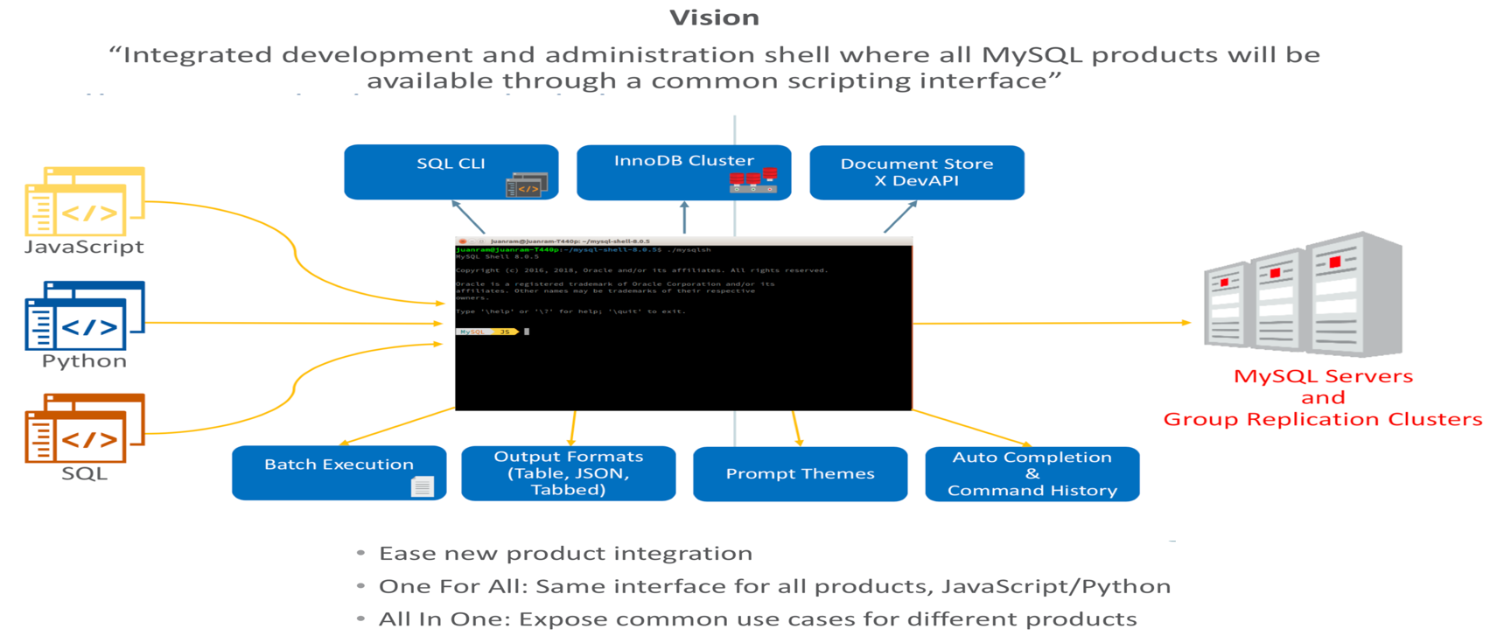
Why use MySQL Shell for InnoDB Cluster
Pluggable architecture - developers can extend by creating custom plugins for specific use cases.

Slide 114
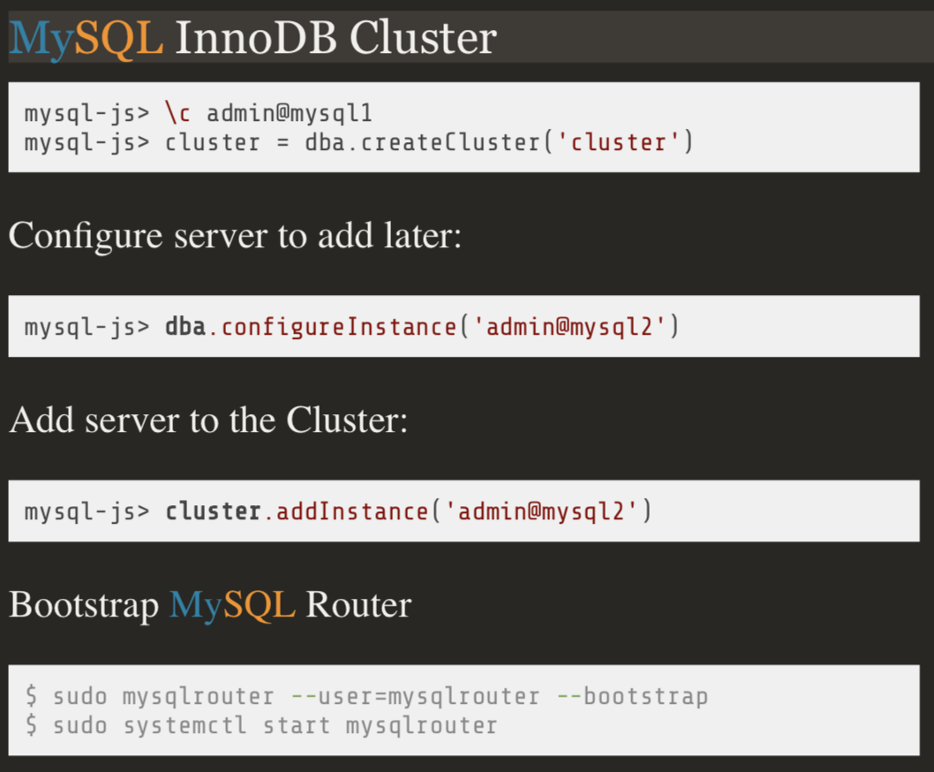

How to Configure InnoDB Cluster
Copyright © 2020 Oracle and/or its affiliates.
Notes:
- As many of you in this room would probably know, MySQL has proven itself to be the best open-source solution for OLTP.
The topic of this talk is; how can one run real-time and high-performance Analytics over the same transactional store?
While MySQL provides high throughput for insert/update-intensive workloads, it is not well suited for plowing through large amounts of data for Analytics processing. And also, running both OLTP and Analytics on the same resources introduces complexity to balance the computational requirements of the two.
The alternative is to run Analytics outside of MySQL, either on-prem or in the cloud. Both require maintaining two separate systems; one for OLTP, one for Analytics, and migrating data from MySQL to Analytics and preclude real-time Analytics on the transactional store, provided by MySQL.

Slide 115

Group Replication - Single Primary Mode
Distributed service auto-detects failures
Group decides if a server is down
Isolated servers are taken offline
Copyright © 2020 Oracle and/or its affiliates.
Notes:
- As many of you in this room would probably know, MySQL has proven itself to be the best open-source solution for OLTP.
The topic of this talk is; how can one run real-time and high-performance Analytics over the same transactional store?
While MySQL provides high throughput for insert/update-intensive workloads, it is not well suited for plowing through large amounts of data for Analytics processing. And also, running both OLTP and Analytics on the same resources introduces complexity to balance the computational requirements of the two.
The alternative is to run Analytics outside of MySQL, either on-prem or in the cloud. Both require maintaining two separate systems; one for OLTP, one for Analytics, and migrating data from MySQL to Analytics and preclude real-time Analytics on the transactional store, provided by MySQL.

Slide 116

Group Replication - Multi Primary Mode
All servers are R/W
If one server is down, client can connect to other node
Copyright © 2020 Oracle and/or its affiliates.
Notes:
- As many of you in this room would probably know, MySQL has proven itself to be the best open-source solution for OLTP.
The topic of this talk is; how can one run real-time and high-performance Analytics over the same transactional store?
While MySQL provides high throughput for insert/update-intensive workloads, it is not well suited for plowing through large amounts of data for Analytics processing. And also, running both OLTP and Analytics on the same resources introduces complexity to balance the computational requirements of the two.
The alternative is to run Analytics outside of MySQL, either on-prem or in the cloud. Both require maintaining two separate systems; one for OLTP, one for Analytics, and migrating data from MySQL to Analytics and preclude real-time Analytics on the transactional store, provided by MySQL.

Slide 117

Group Replication Consistency - Eventual
Copyright © 2020 Oracle and/or its affiliates.
Notes:
- As many of you in this room would probably know, MySQL has proven itself to be the best open-source solution for OLTP.
The topic of this talk is; how can one run real-time and high-performance Analytics over the same transactional store?
While MySQL provides high throughput for insert/update-intensive workloads, it is not well suited for plowing through large amounts of data for Analytics processing. And also, running both OLTP and Analytics on the same resources introduces complexity to balance the computational requirements of the two.
The alternative is to run Analytics outside of MySQL, either on-prem or in the cloud. Both require maintaining two separate systems; one for OLTP, one for Analytics, and migrating data from MySQL to Analytics and preclude real-time Analytics on the transactional store, provided by MySQL.

Slide 118

Group Replication Consistency - Before
Copyright © 2020 Oracle and/or its affiliates.
Notes:
- As many of you in this room would probably know, MySQL has proven itself to be the best open-source solution for OLTP.
The topic of this talk is; how can one run real-time and high-performance Analytics over the same transactional store?
While MySQL provides high throughput for insert/update-intensive workloads, it is not well suited for plowing through large amounts of data for Analytics processing. And also, running both OLTP and Analytics on the same resources introduces complexity to balance the computational requirements of the two.
The alternative is to run Analytics outside of MySQL, either on-prem or in the cloud. Both require maintaining two separate systems; one for OLTP, one for Analytics, and migrating data from MySQL to Analytics and preclude real-time Analytics on the transactional store, provided by MySQL.

Slide 119

Group Replication Consistency - After
Copyright © 2020 Oracle and/or its affiliates.
Notes:
- As many of you in this room would probably know, MySQL has proven itself to be the best open-source solution for OLTP.
The topic of this talk is; how can one run real-time and high-performance Analytics over the same transactional store?
While MySQL provides high throughput for insert/update-intensive workloads, it is not well suited for plowing through large amounts of data for Analytics processing. And also, running both OLTP and Analytics on the same resources introduces complexity to balance the computational requirements of the two.
The alternative is to run Analytics outside of MySQL, either on-prem or in the cloud. Both require maintaining two separate systems; one for OLTP, one for Analytics, and migrating data from MySQL to Analytics and preclude real-time Analytics on the transactional store, provided by MySQL.

Slide 120

Group Replication Consistency - Before and After
Copyright © 2020 Oracle and/or its affiliates.
Notes:
- As many of you in this room would probably know, MySQL has proven itself to be the best open-source solution for OLTP.
The topic of this talk is; how can one run real-time and high-performance Analytics over the same transactional store?
While MySQL provides high throughput for insert/update-intensive workloads, it is not well suited for plowing through large amounts of data for Analytics processing. And also, running both OLTP and Analytics on the same resources introduces complexity to balance the computational requirements of the two.
The alternative is to run Analytics outside of MySQL, either on-prem or in the cloud. Both require maintaining two separate systems; one for OLTP, one for Analytics, and migrating data from MySQL to Analytics and preclude real-time Analytics on the transactional store, provided by MySQL.

Slide 121
Group Replication: Fault Tolerance
Paxos distributed algorithm
n = (2 * f) + 1
n = number of servers
f = number of failures
Minimum number in group = 3
Maximum number in group = 9
Group Size (n) | Majority | Failures Tolerated (f)
1 | 1 | 0
2 | 2 | 0
3 | 2 | 1
4 | 3 | 1
5 | 3 | 2
6 | 4 | 2
7 | 4 | 3
8 | 5 | 3
9 | 5 | 4
Copyright © 2020 Oracle and/or its affiliates.
Notes:
- As many of you in this room would probably know, MySQL has proven itself to be the best open-source solution for OLTP.
The topic of this talk is; how can one run real-time and high-performance Analytics over the same transactional store?
While MySQL provides high throughput for insert/update-intensive workloads, it is not well suited for plowing through large amounts of data for Analytics processing. And also, running both OLTP and Analytics on the same resources introduces complexity to balance the computational requirements of the two.
The alternative is to run Analytics outside of MySQL, either on-prem or in the cloud. Both require maintaining two separate systems; one for OLTP, one for Analytics, and migrating data from MySQL to Analytics and preclude real-time Analytics on the transactional store, provided by MySQL.

Slide 122
Common System Variables
group_replication_exist_state_action (Admin API: exitStateAction), values: ABORT_SERVER, OFFLINE_MODE, READ_ONLY
group_replication_member_weight (Admin API: memberWeight). values range from 0 to 100
group_replication_member_expel_timeout (Admin API: expelTimeout), values: 0 or greater than 0
group_replication_autorejoin_tries (Admin API: autoRejoinTries), values: 0 to 2016
Copyright © 2020 Oracle and/or its affiliates.
Notes:
- As many of you in this room would probably know, MySQL has proven itself to be the best open-source solution for OLTP.
The topic of this talk is; how can one run real-time and high-performance Analytics over the same transactional store?
While MySQL provides high throughput for insert/update-intensive workloads, it is not well suited for plowing through large amounts of data for Analytics processing. And also, running both OLTP and Analytics on the same resources introduces complexity to balance the computational requirements of the two.
The alternative is to run Analytics outside of MySQL, either on-prem or in the cloud. Both require maintaining two separate systems; one for OLTP, one for Analytics, and migrating data from MySQL to Analytics and preclude real-time Analytics on the transactional store, provided by MySQL.

Slide 123
Basic Cluster Administration
dba.getCluster().status() - checking cluster status
dba.getCluster().describe() - viewing the structure of a cluster
dba.getCluster().rescan() - Display any discovered instance and ask if you want to rejoin them to cluster
dba.getCluster().addInstance(‘user@host:port’) - add instance to cluster
dba.getCluster().removeInstance(’user@host:port’) - remove instance from cluster
dba.getCluster().rejoinInstance(‘user@host:port’) - for instance that has left cluster and not able to rejoin automatically.
dba.getCluster().setPrimaryInstance(‘user@host:port’) - choose primary node
dba.getCluster().forceQuorumUsingPartitionOf(‘localhost:port’) - restoring quorum loss
dba.rebootClusterFromCompleteOutage() - start cluster after instances are restrated
Copyright © 2020 Oracle and/or its affiliates.
Notes:
- As many of you in this room would probably know, MySQL has proven itself to be the best open-source solution for OLTP.
The topic of this talk is; how can one run real-time and high-performance Analytics over the same transactional store?
While MySQL provides high throughput for insert/update-intensive workloads, it is not well suited for plowing through large amounts of data for Analytics processing. And also, running both OLTP and Analytics on the same resources introduces complexity to balance the computational requirements of the two.
The alternative is to run Analytics outside of MySQL, either on-prem or in the cloud. Both require maintaining two separate systems; one for OLTP, one for Analytics, and migrating data from MySQL to Analytics and preclude real-time Analytics on the transactional store, provided by MySQL.

Slide 124
Thank you

